Slide 1







4-bit Microprocessor Design and Implementation
CND 221:ADVANCED FULL CUSTOM VLSI DESIGN

Slide 2
Team Members
Student Name | ID
Muhammed Khaled Omar Orabi | V23010695
Ahmed mohamed mohamed shawky Elattar | V23010568
Mohammed Salah Aboshosha Mohammed | V23010141
Omar Dyaa Mohammed Mohamed | V23010501
Amr mohamed ali hassan | V23010177

Slide 3
Project Description:
This project Aims to develop and implement 4 bits microprocessor. In this project, students will delve into the intricate aspects of microprocessor layout and circuit design. The project will emphasize hands-on experience in creating circuit designs, layout designs, and verifications for critical microprocessor components, such as the ALU, memory, control unit, and other circuitry using custom and standard cell libraries. This project involves the schematic and layout design of a 4-bit microprocessor data path, including an ALU, a barrel shifter, and a register file using CMOS circuitry and Siemens VLSI design tools. The project will incorporate all the skills and knowledge students have gained from the individual lab assignments and provide a team of students with an opportunity to work on a more open-ended digital integrated circuits design problem

Slide 4
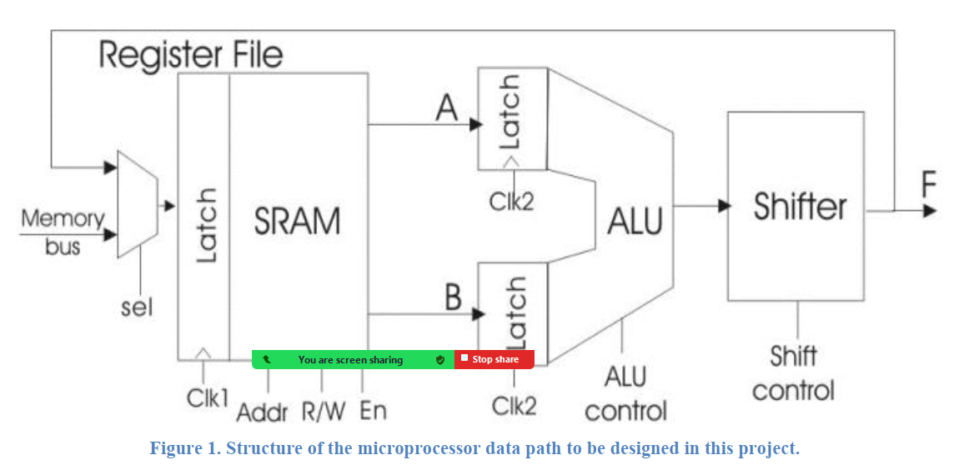
Project Description:

Slide 5
DataPath:
The data path is the core element of a microprocessor that can perform many functions, including arithmetic and logic evaluation, data movement, and storage of results in a memory address specified by the instruction. In this design project, teams must design a complete 4-bit data path consisting of a register file, an ALU (Arithmetic Logic Unit) and a shifter, as shown in Figure 1. The data path will be capable of multiple instructions determined by several control signals.

Slide 6
DataPath:
The ALU can perform both arithmetic and bit-wise logical operations. The ALU will have two 4-bit data inputs and several control signals that specify the ALU function to be executed in a given clock cycle. The ALU input data is loaded into the latch at the rising edge of the ALU clock (clk2), and the output is generated after a delay due propagation through the combinational logic of the ALU and the shifter. The central component of an ALU is an adder, and for this project a Carry select adder will be used. A shifter provides data manipulation capabilities. A barrel shifter will be used because it has a very efficient layout and can perform n-bit shifts in a single clock cycle. The register file is a block of memory that provides the data inputs to and stores outputs from the ALU. The register file at read/write address is specified by control bits included in the opcode. In this project, the register file and ALU/shifter will be synchronized by two nonoverlapping clock phases that determine when data is latched into the register file (clk1) and into the ALU (clk2).

Slide 7
DataPath Design Specifications:
The following specifications must be achieved by the data path you design: a. Bit width: 4 b. Inputs: one 4-bit word (from the memory bus), 13 control/address bits (6 for the ALU/shifter, 7 for the register file), two non-overlapping clocks (clk1, clk2). c. Outputs: 4-bit word (F), 1 carry-out d. Functions: must implement at least the following functions:

Slide 8
ALU functions:
A NOR B • A XOR B • A NAND B • NOT A (invert) • Increment A • Decrement A • A + B • A * B (Bonus Function) If you implement only these functions, you must do so with only three ALU control signals. There is no explicit Cin bit; Cin must be generated from the ALU control bits

Slide 9
Shifter
The shifter must implement: • Pass (no shift) • Shift left 1. • Shift left 2. • Shift right 1. • Shift right 2. • Rotate right 1. • Rotate left 1.

Slide 10
Expanded functions
Two function expansion bits can be provided to implement additional ALU and/or shifter functions.
Register file The 4x4 SRAM register file must implement 2-port read_from_memory and 1-port write_to_memory functions. Each clock cycle will be either a read or a write cycle, so two cycles will be needed to complete a function. e. Power supply: VDD = 3 volts, referenced to 0-volt ground. f. Size specifications: no specific layout size is required, but optimization of physical size is a design priority, and higher scores will be awarded to groups with smaller layouts. The floorplan in Fig. 2 will assist in achieving an optimal layout. g. Timing specifications: signal timing requirements are defined below. The worst-case propagation delay for all ALU + shifter functions must be optimized (e.g., less than 50ns)

Slide 11
Control Bit Specifications:
ntrol Bit Specifications: It is recommended to complete this project with only the following 13 control signals: 1-bit register file input mux selection, two 2-bit register addresses, 1-bit register file read/write, 1-bit register file enable, 3- ALU controls, and 3-bits shift controls. These control signals must be given the signal names defined below. Note: this only defines the externally-supplied control signals; you can decode or otherwise manipulate them to construct any necessary internal control signals.

Slide 12
Data Path Layout
The 4-bit datapath can be implemented by constructing a 1-bit slice horizontally and stacking 4 one-bit slices vertically. This layout floorplan for the data path is shown in Fig. 2. The data flows horizontally from the left to the right. The control signals run vertically across each slice. You may implement some functional blocks as 4 bits, but make sure you organize it in 1-bit slices that can be pitch-matched to the other functional blocks.

Slide 13
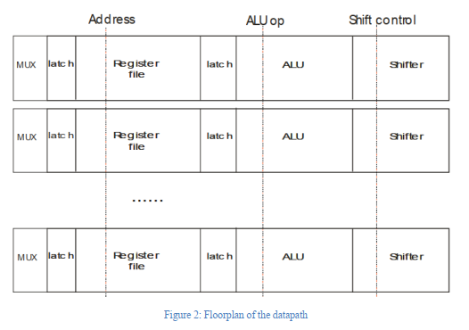
Data Path Layout

Slide 14
Register File Description:
The 4-bit register file should be implemented as a 4x4 SRAM. Since the SRAM is small, you do not have to implement a sense amplifier. The register file should have two 4-bit read (output) ports and one 4- bit write (input) port. Input to the register file can come either from the ALU output for from an external memory bus, as selected by a MUX at the input of the register file. The memory bus should be implemented as a 4-bit input word. A 4-bit latch should be included to store the register file input word, which, during a write cycle, will be saved to the SRAM block. The register file uses an enable signal for the general task of enabling inputs to and outputs from the register file at the proper time. The register file must be carefully designed to properly implement the enable function. In the read cycle, register file output is passed to the ALU when enable is high; otherwise, that output should be at high impedance. The output should also be at high impedance during the entire write cycle, when the R/W signal is high. In the write cycle, data is stored in the SRAM only when enable is high; otherwise, the data from the register file latch should not be allowed to affect the SRAM. To accomplish this, the enable signal should act on the SRAM address decoder outputs. The enable function allows the data path to implement functions that do not act on the register file, such as branches or status register checks, although these functions are not implemented in this design project. The register file address contains two independent 2-bit addresses. Address “A” should specify the address for data passed to ALU input A, and address “B” should specify ALU input B. Address “A” is also used to specify the address for storing data to the SRAM during a write cycle. The timing of the data path should allow the value of address A to be changed before the write cycle, as shown in Fig. 3. However, for this project you can keep the address constant and store the ALU/shifter data back to the same location where input A was taken from.

Slide 15
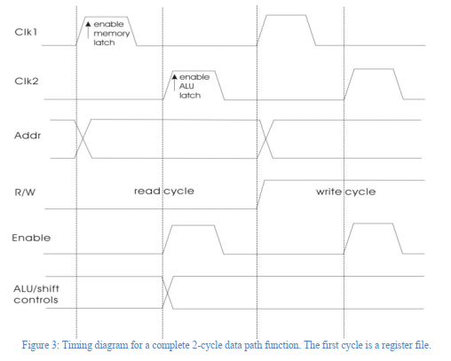
Register File Description:

Slide 16
Clock/Timing Description:
Two non-overlapping clock phases are required for the data path, as shown in Fig. 3. Data from the ALU/shifter or memory is loaded in the register file latch when clk1 is high and held there while clk1 is low. Data from the register file is loaded in the ALU latch when clk2 is high and held there when clk2 is low. Two cycles of the clocks are needed to complete a data path function; data is passed to and through the ALU/shifter in the “read” cycle, and ALU/shifter data is stored in the register file on the “write” cycle. Address and control signals for all data path functions must be synchronized to the clock signals specifically as shown in Fig. 3.

Slide 17
Project Requirements (Deliverables):
The following cell views for all circuit blocks must be created using the available tools: • Schematic, Symbol, and Layout • DRC, LVS, and Parasitic extraction. • Circuit simulation (functional simulation of all datapath functions) • Post layout simulation (functional simulation of all datapath functions after adding PEX file)

Slide 18
Input and output naming:
Inputs o md<0:3>, memory bus data o rfs, reg. file mux selection o rfen, reg. file enable o rw, read/write o ada<0:1>, register address A o adb<0:1>, register address B o f<0:2>, shifter controls o f<3:5>, ALU controls o clk1, clk2 • outputs: o Y<0:3> o Cout

Slide 19
The following characteristics must be measured and reported
o Slowest logic function and propagation delay for that function (ALU)
o Slowest arithmetic function and propagation delay from that function (ALU)
o Slowest propagation delay of the data path (ALU + Shifter)
Hint: Propagation delays are measured from clock edge to last output transition.
o Physical area of the complete data path layout
o Total number of transistors in the data path (available from the final LVS output)
o Total, static, and dynamic power consumption for a full read and write cycle during an ADD and
Shift_Left_2 operations.

Slide 20
Circuit Requirements
o A Carry select adder must be implemented. o A barrel shifter must be implemented. o The register file memory must be implemented with a multi-port 4x4 SRAM. o Minimum sized transistors can be used, but are not required. o All required functions must be implemented using only the specified control/select inputs. Page 6 of 6 CND 221 – Final Project o You must employ hierarchical design where you instantiate lower-level cells into higher level circuit block, both in schematic and layout design o Buffers should be designed and included wherever fan-out is larger than 5 gates. Hint: It is always best to pass DRC and LVS on smaller cells BEFORE using them to construct larger cells. Final LVS can be very time consuming for many groups

Slide 21
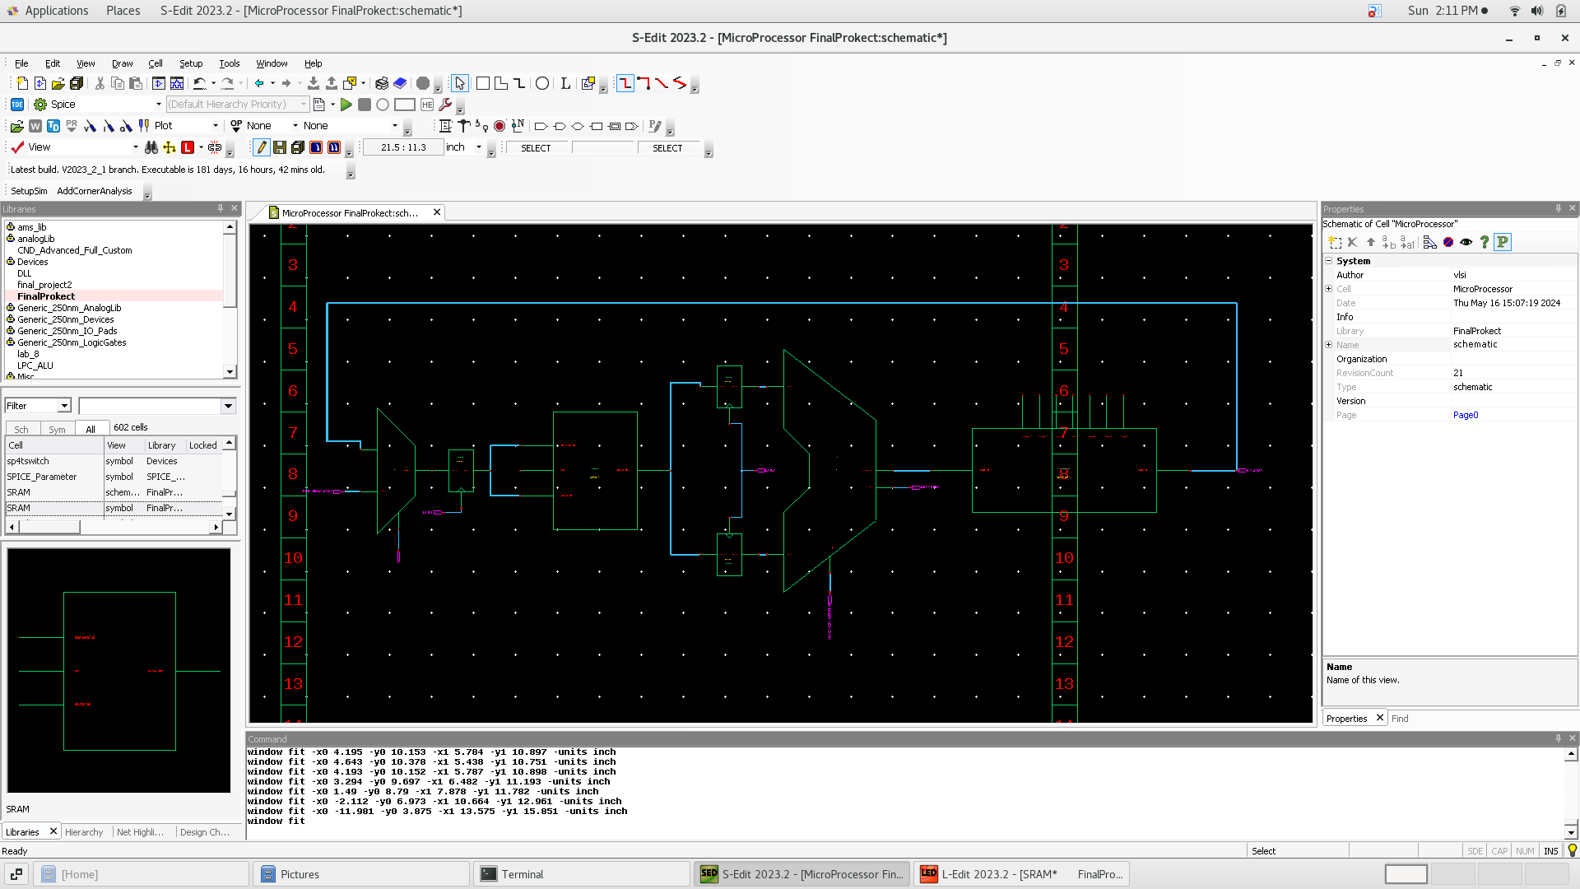
Final project

Slide 22
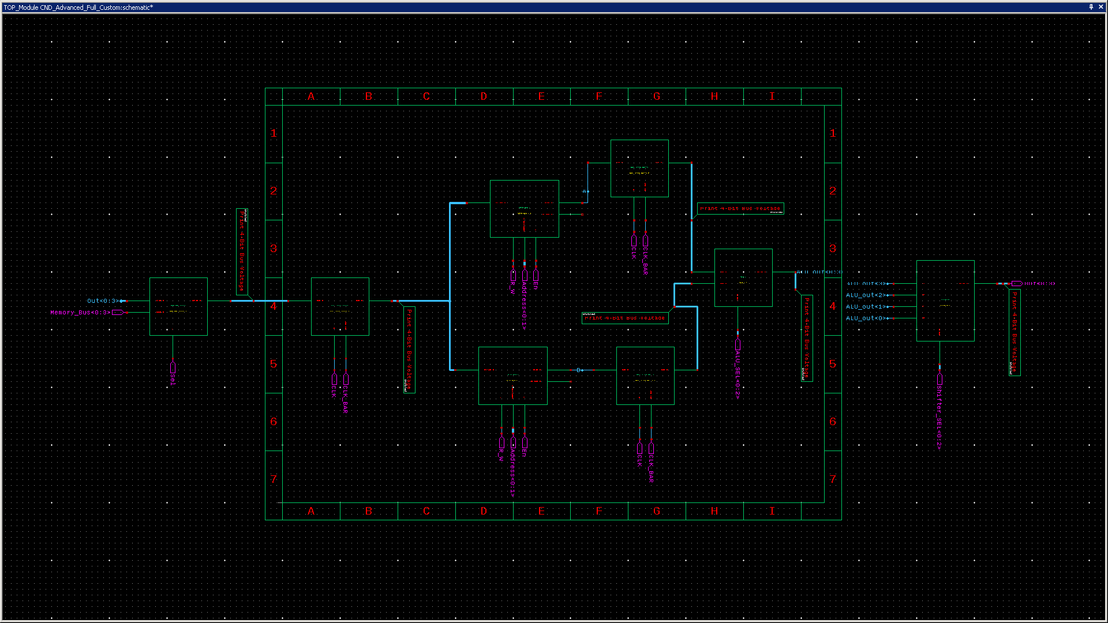
Top module

Slide 23
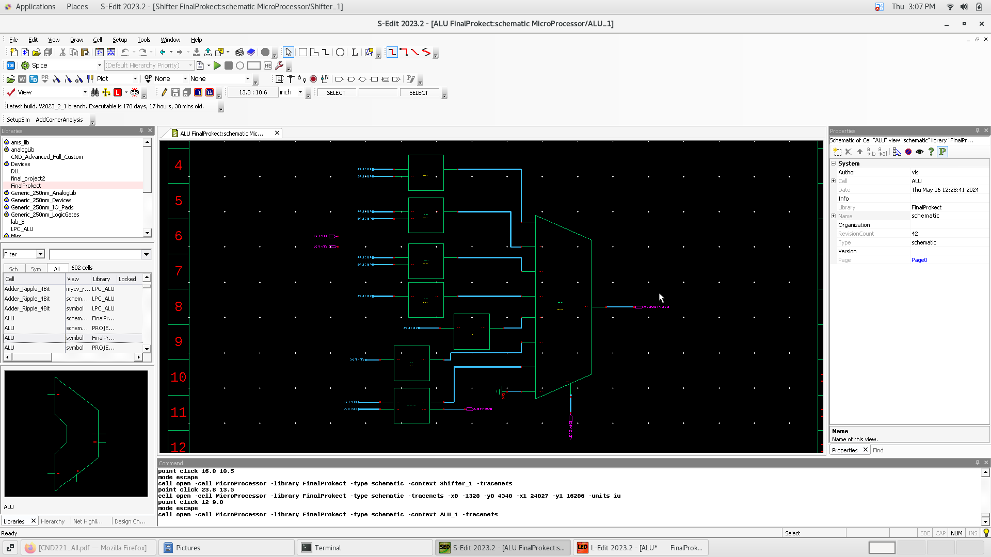
alu

Slide 24
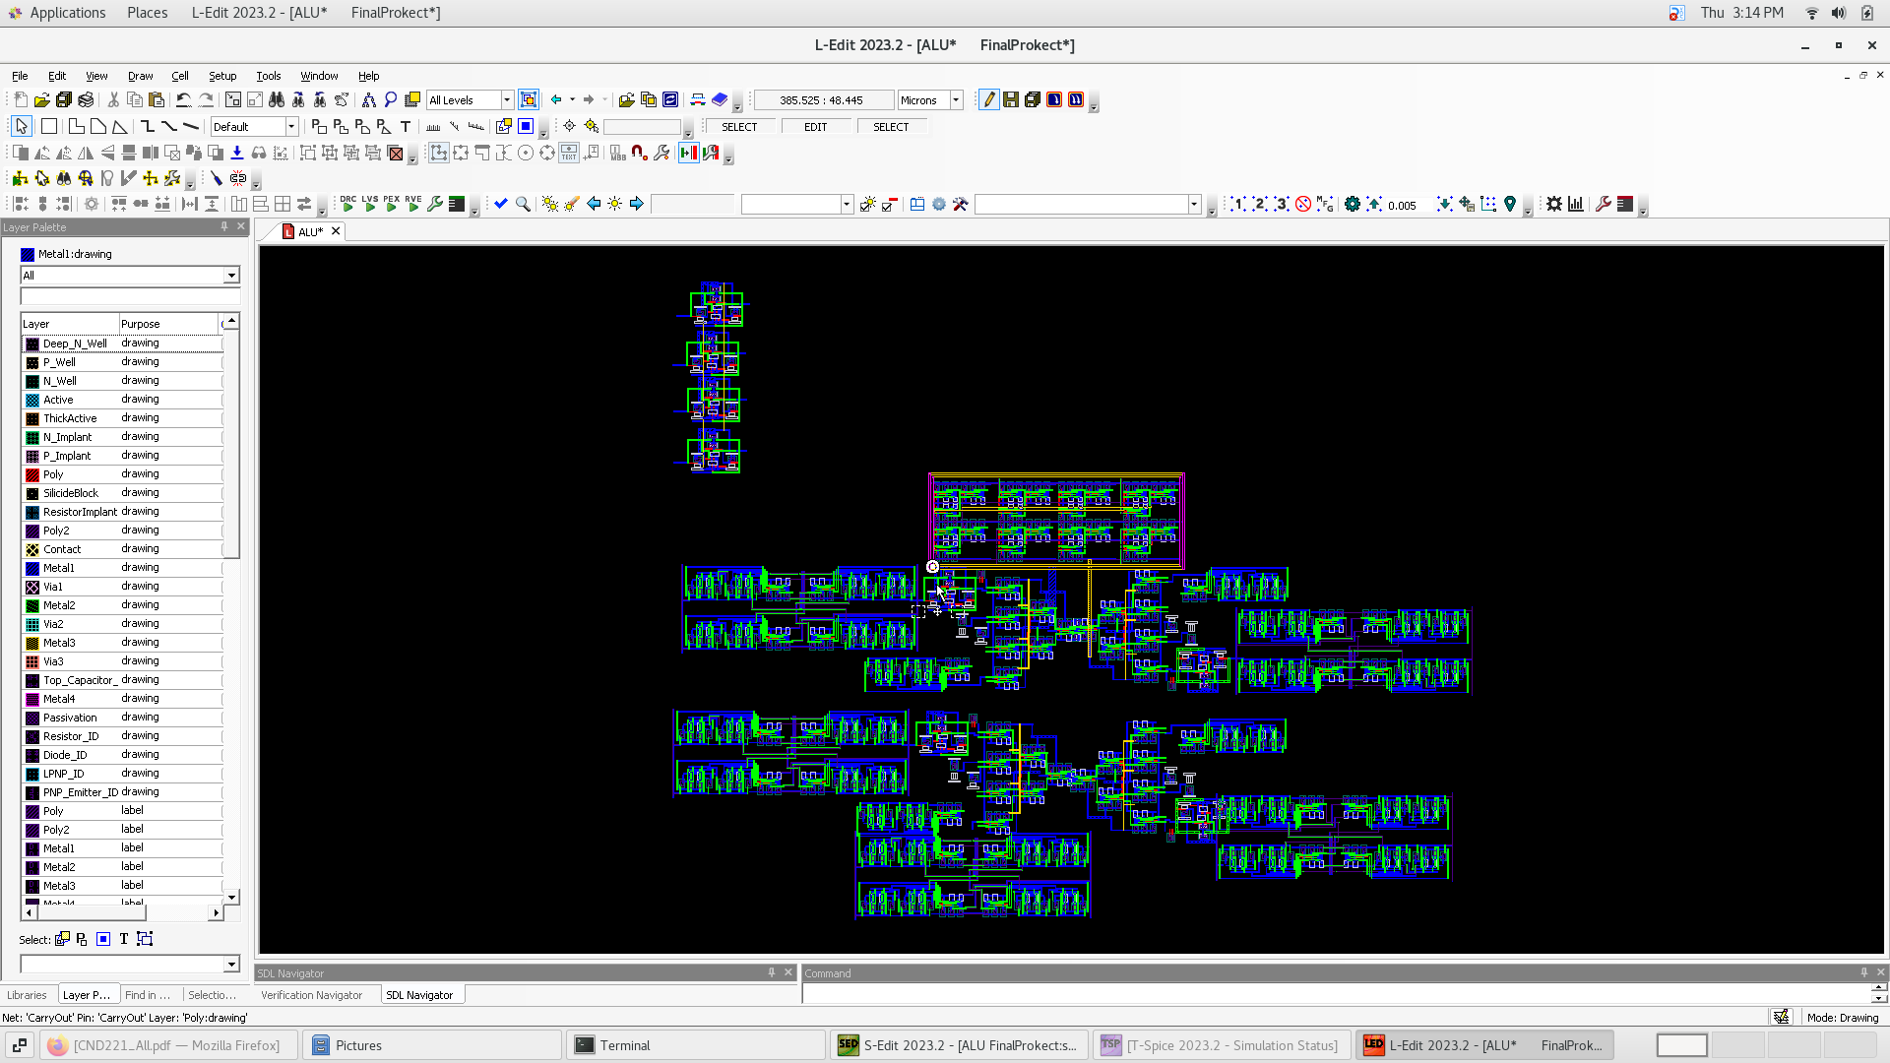
alu

Slide 25
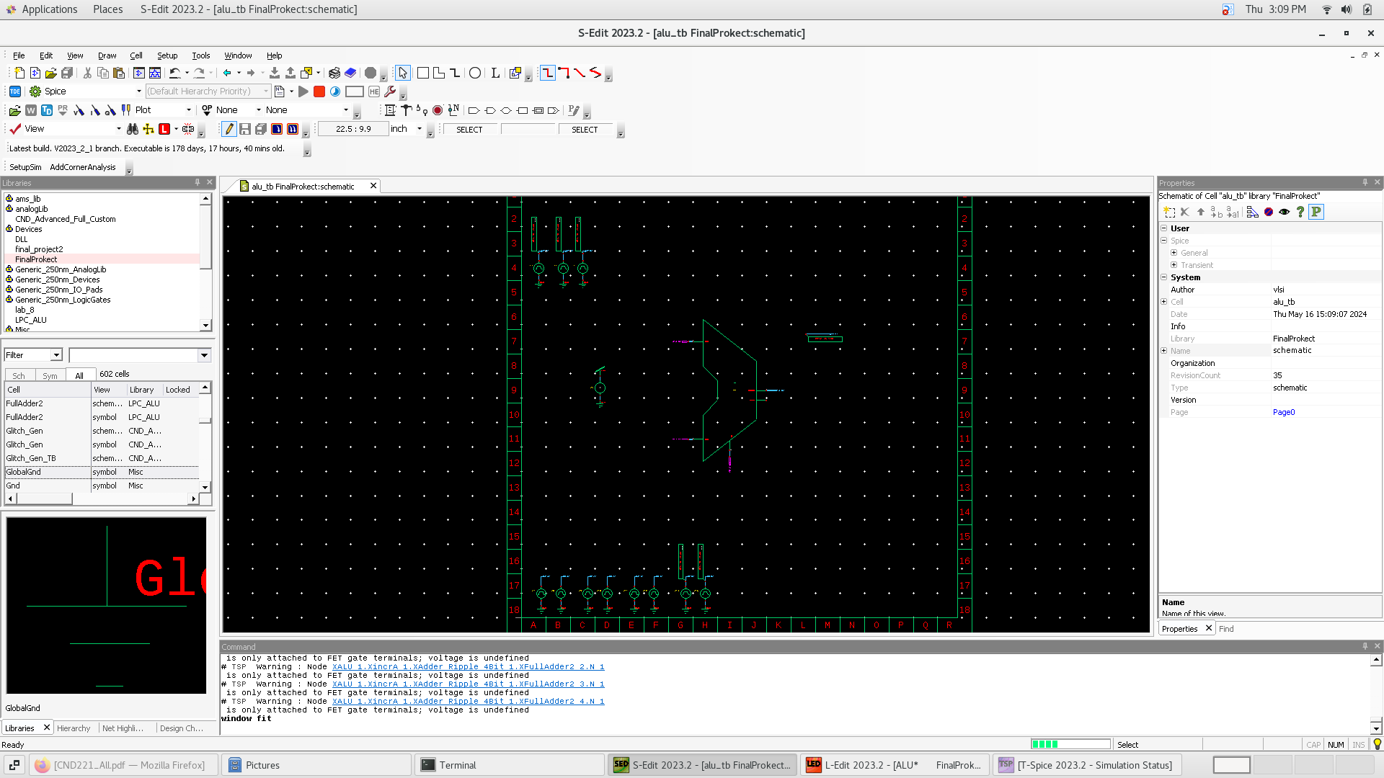
Alu tb

Slide 26
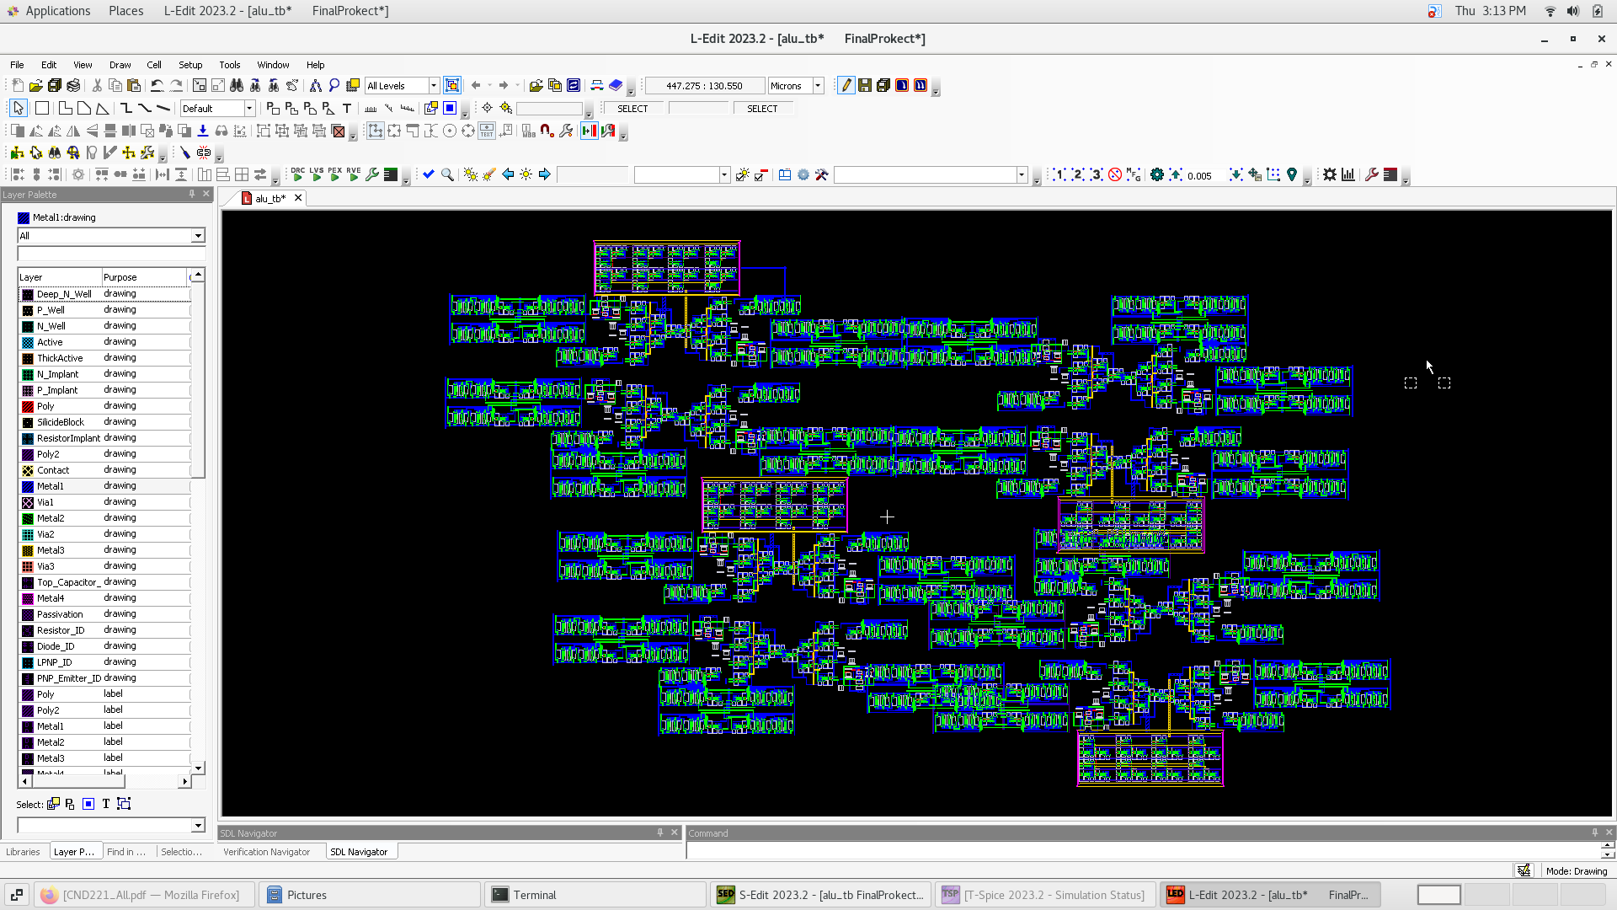
Alu tb

Slide 27
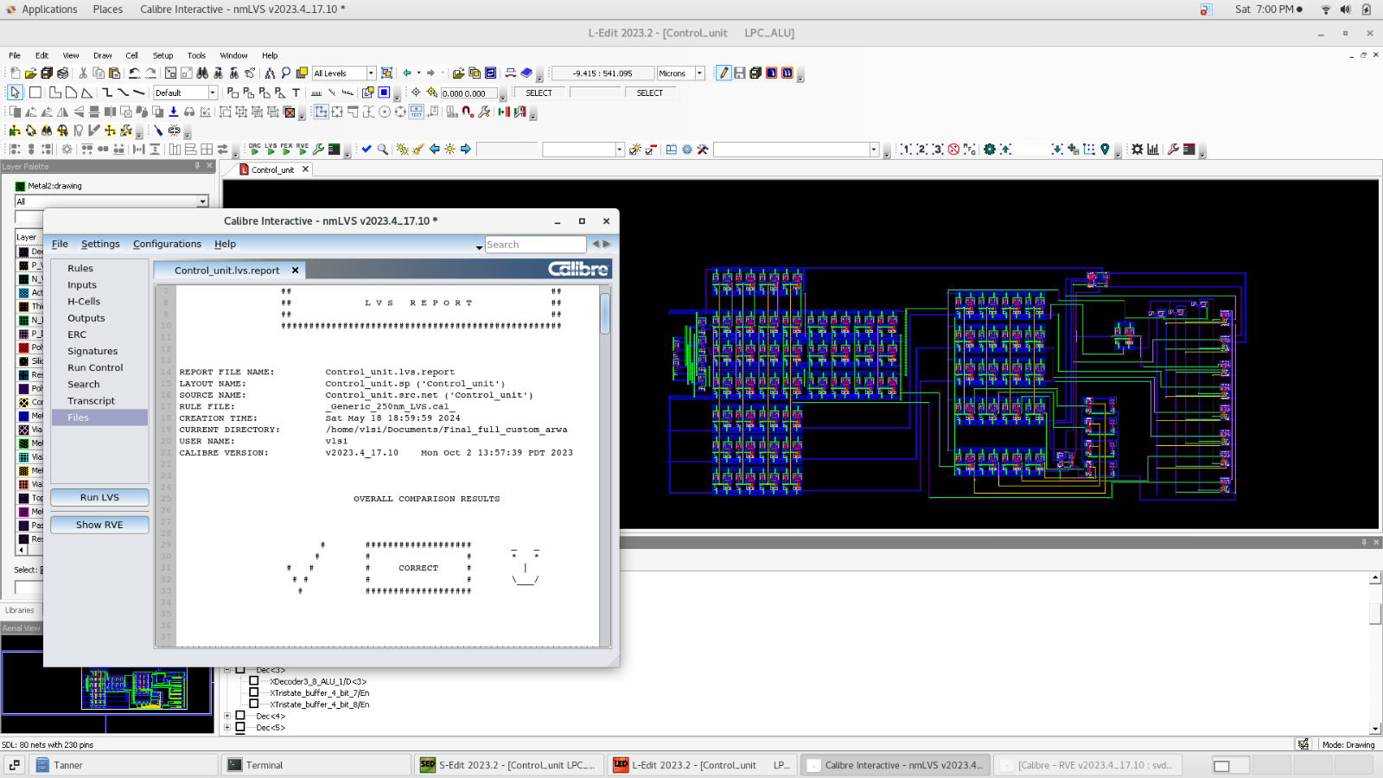
Control unit

Slide 28
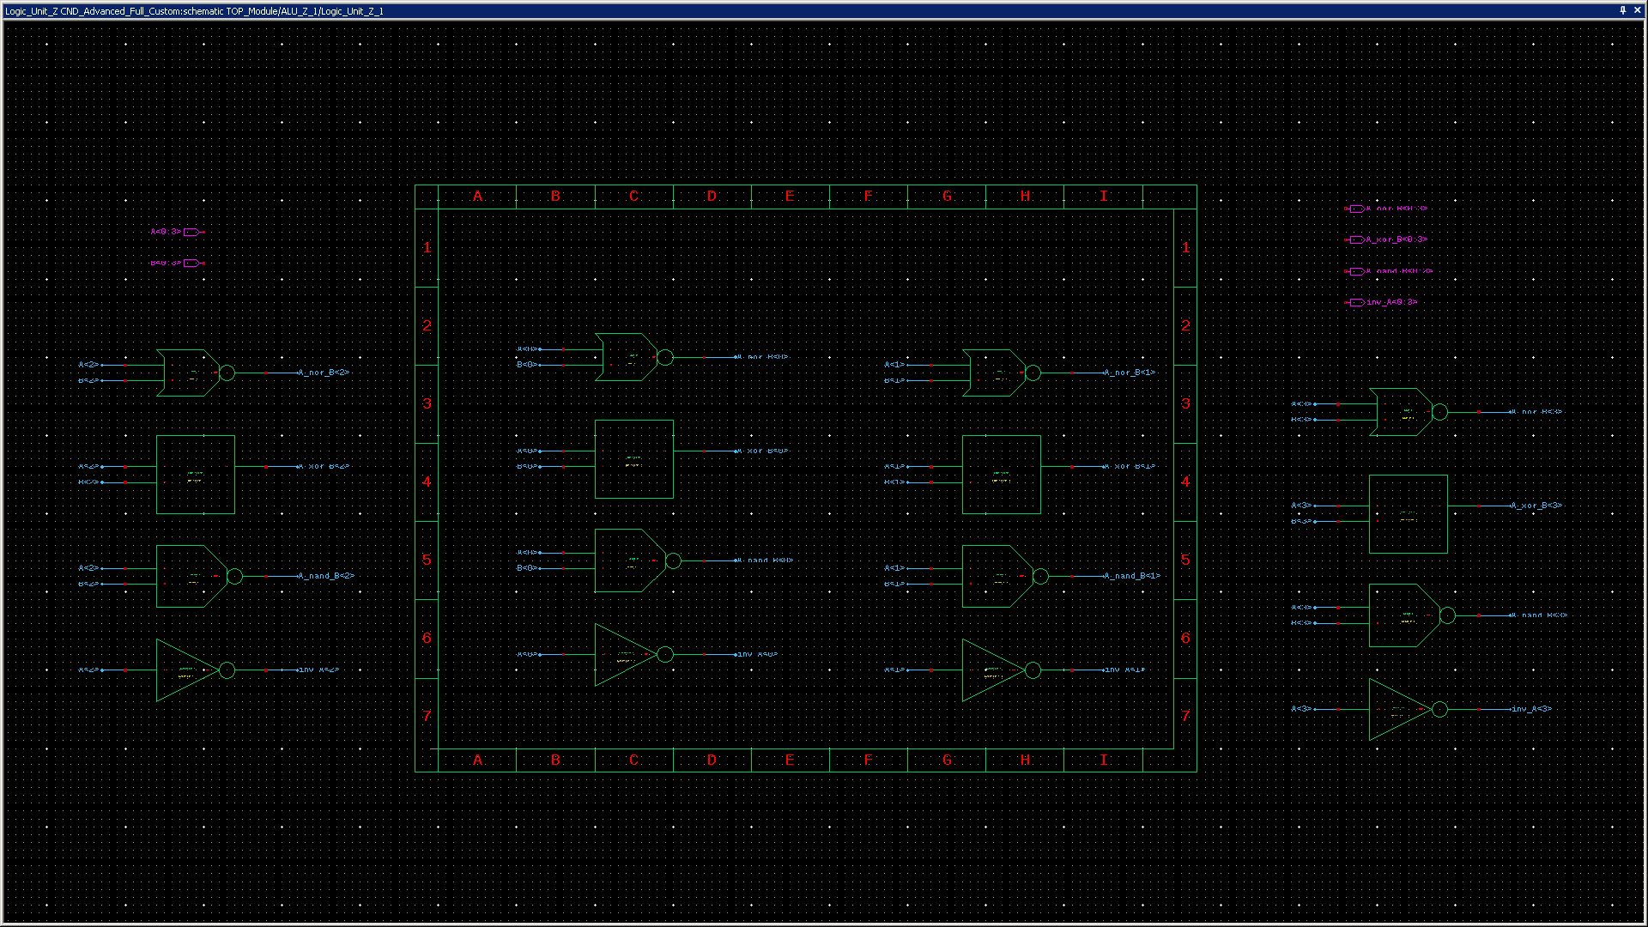
Logic unit

Slide 29
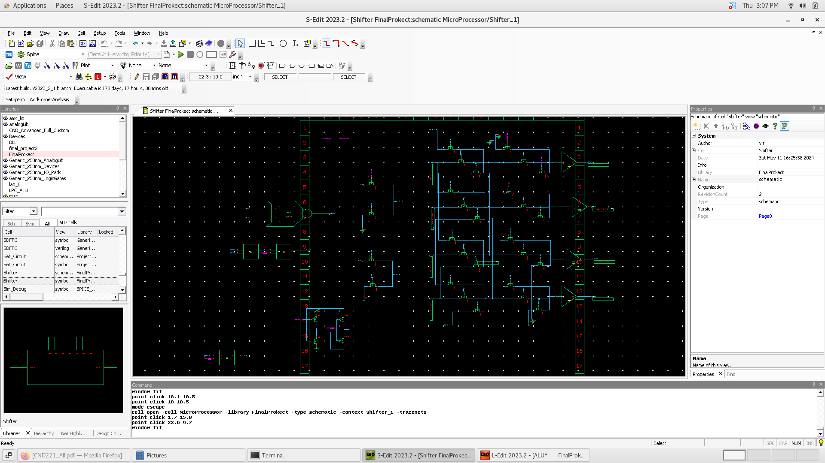
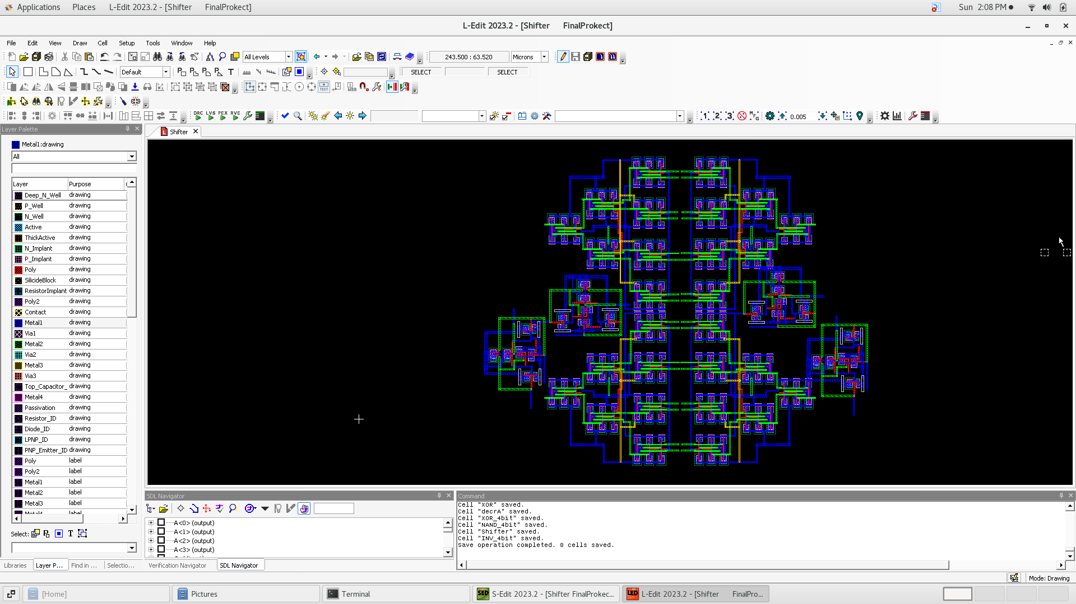
shifter

Slide 30
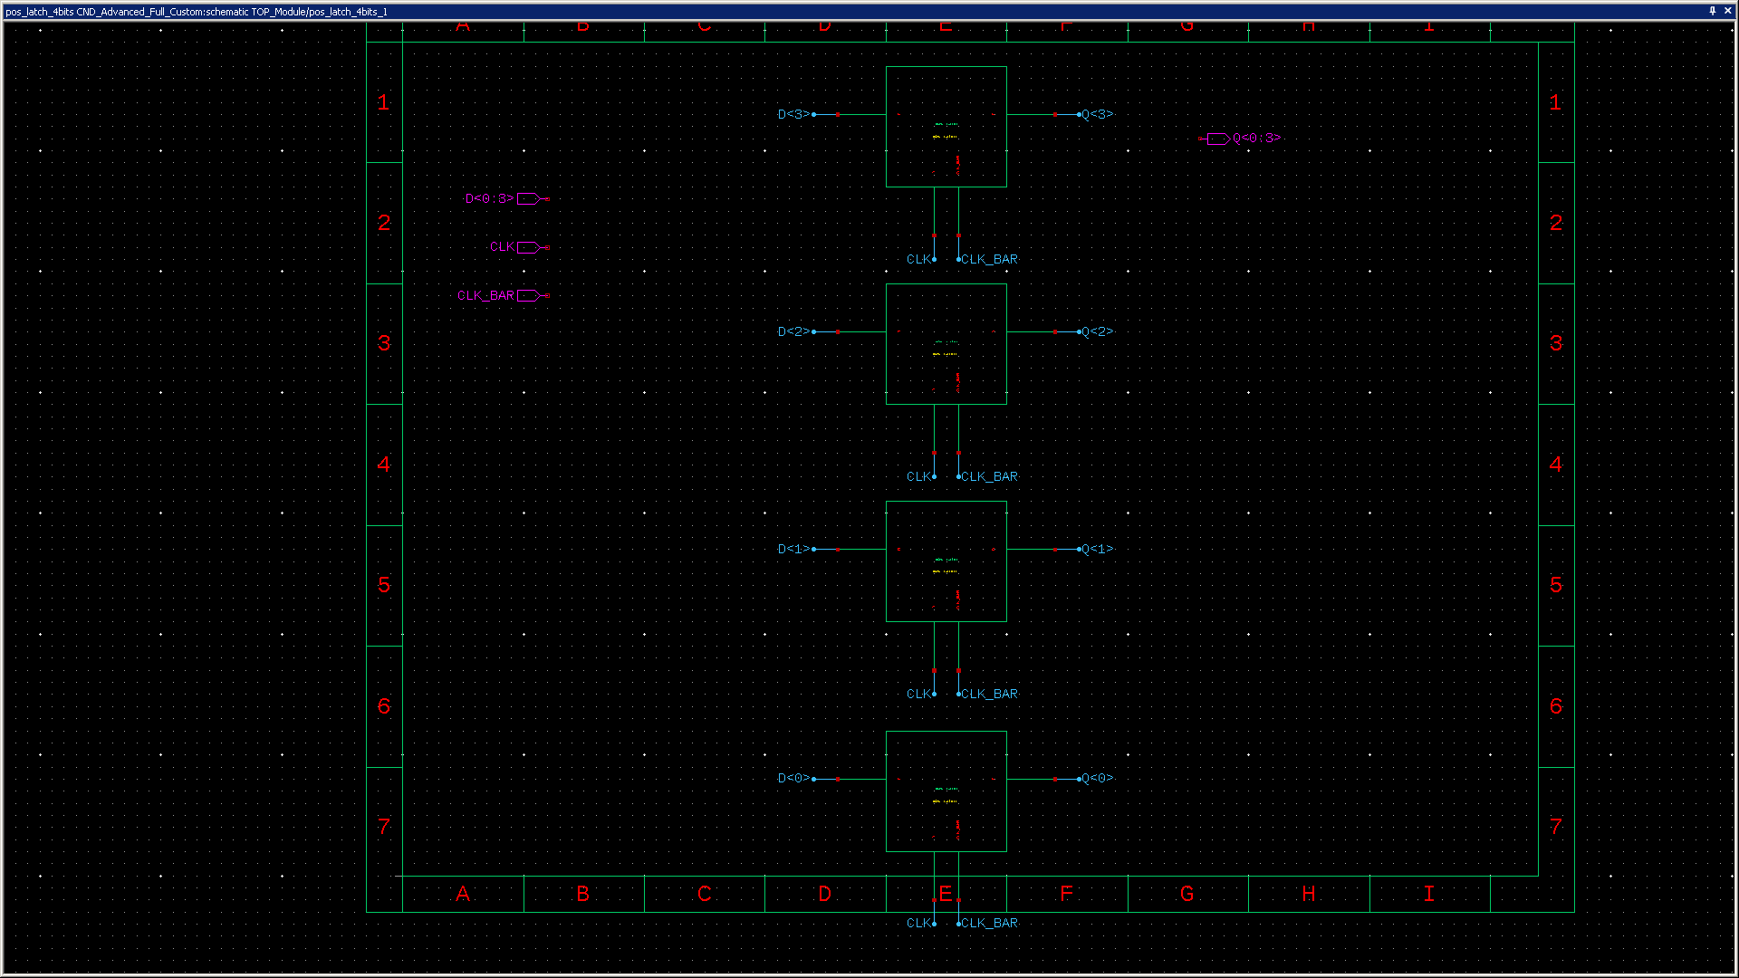
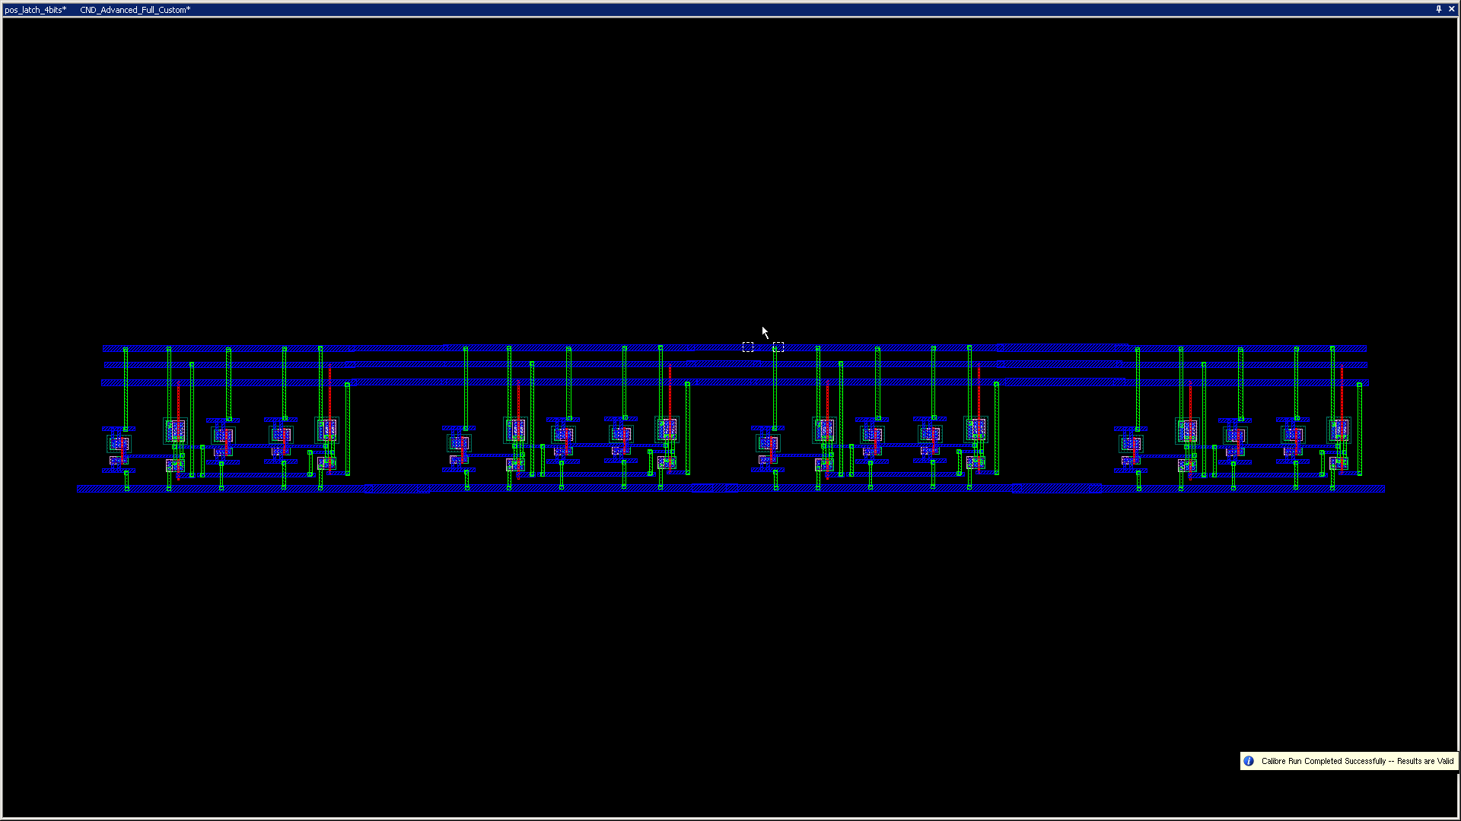
4bit latch

Slide 31
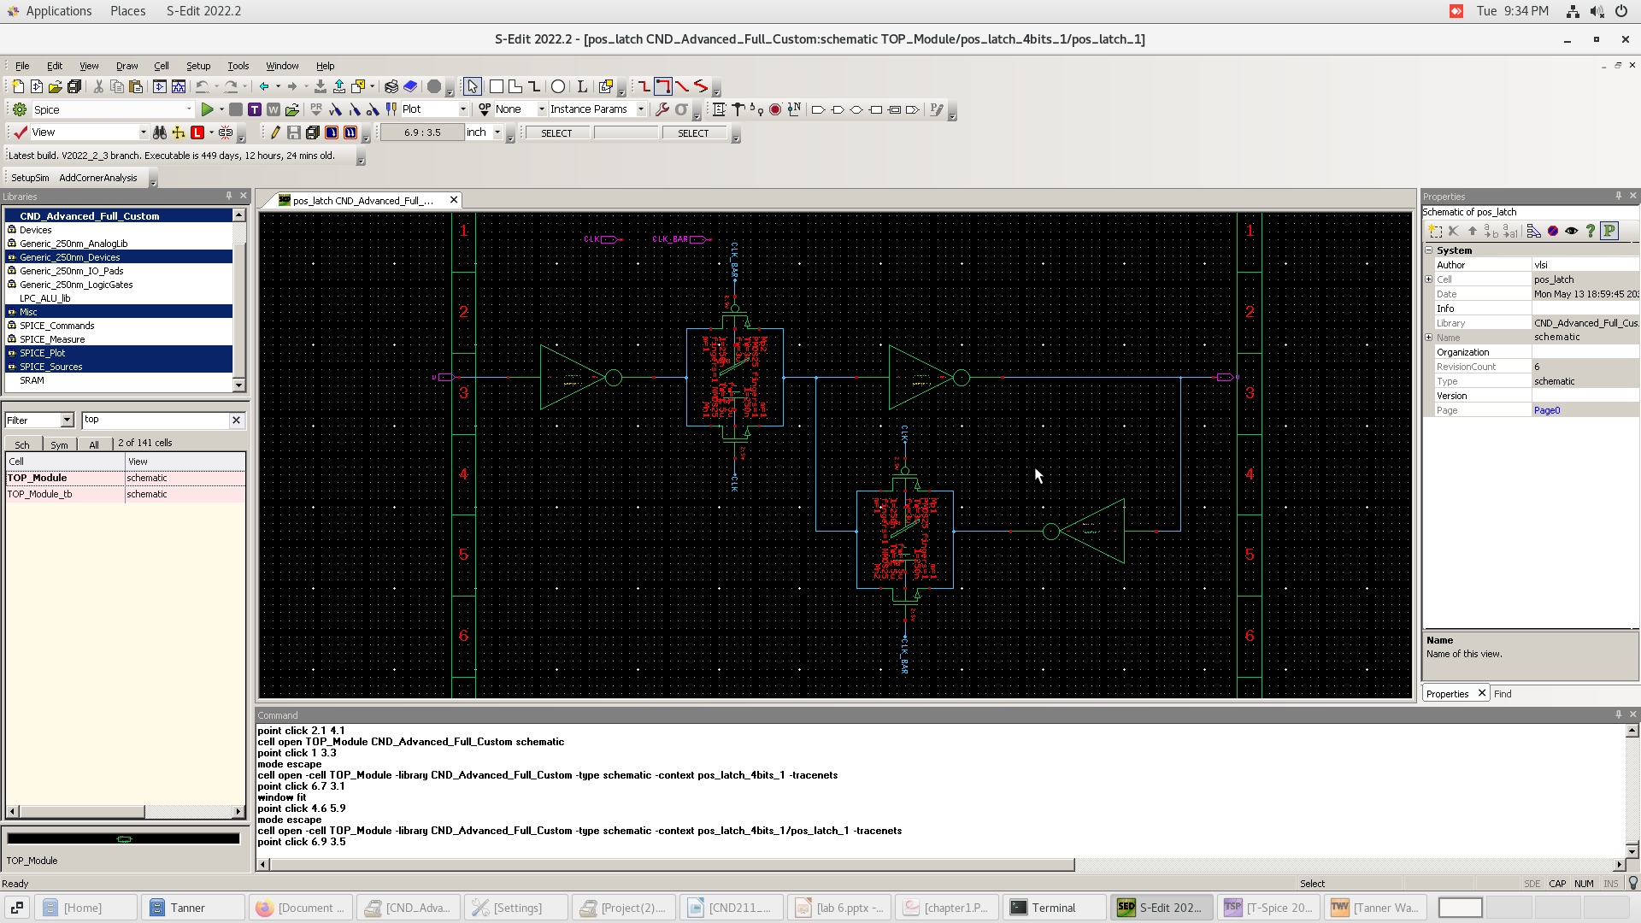
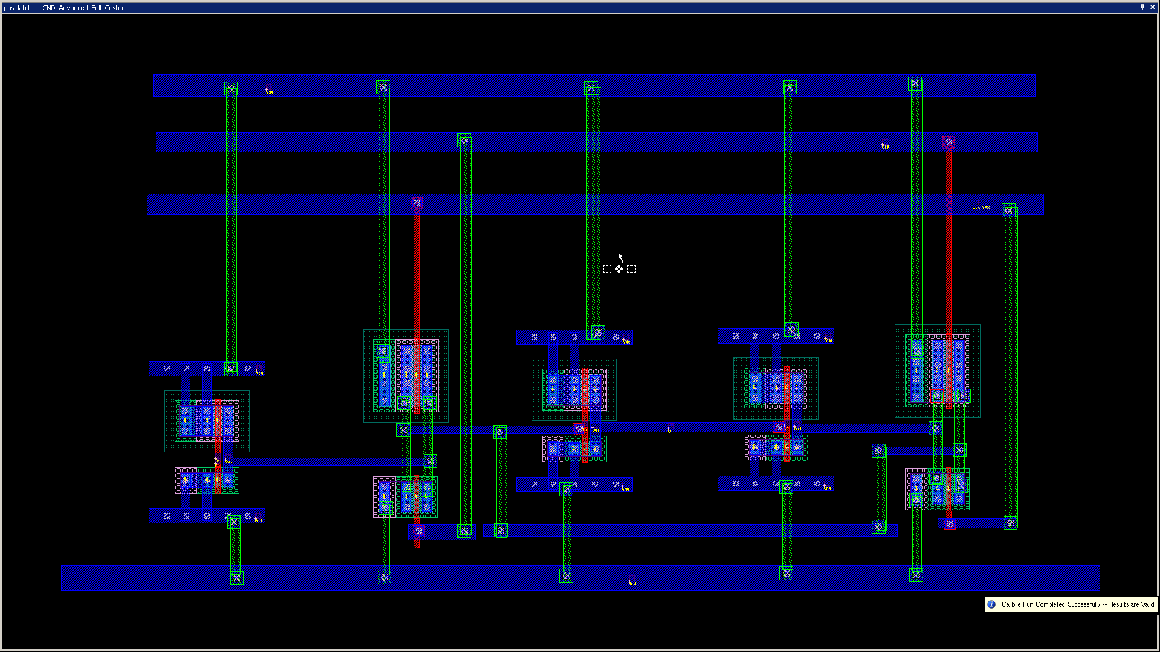
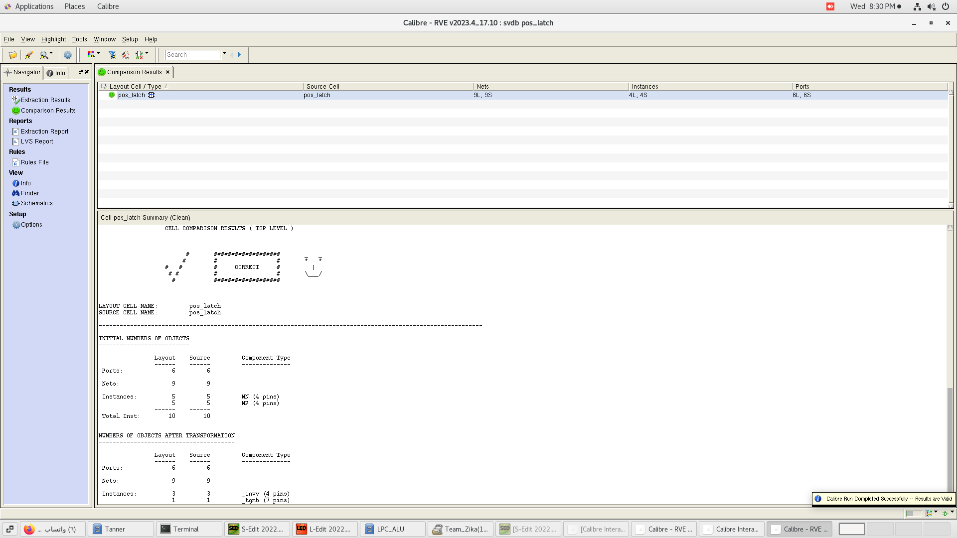
Pos latch

Slide 32
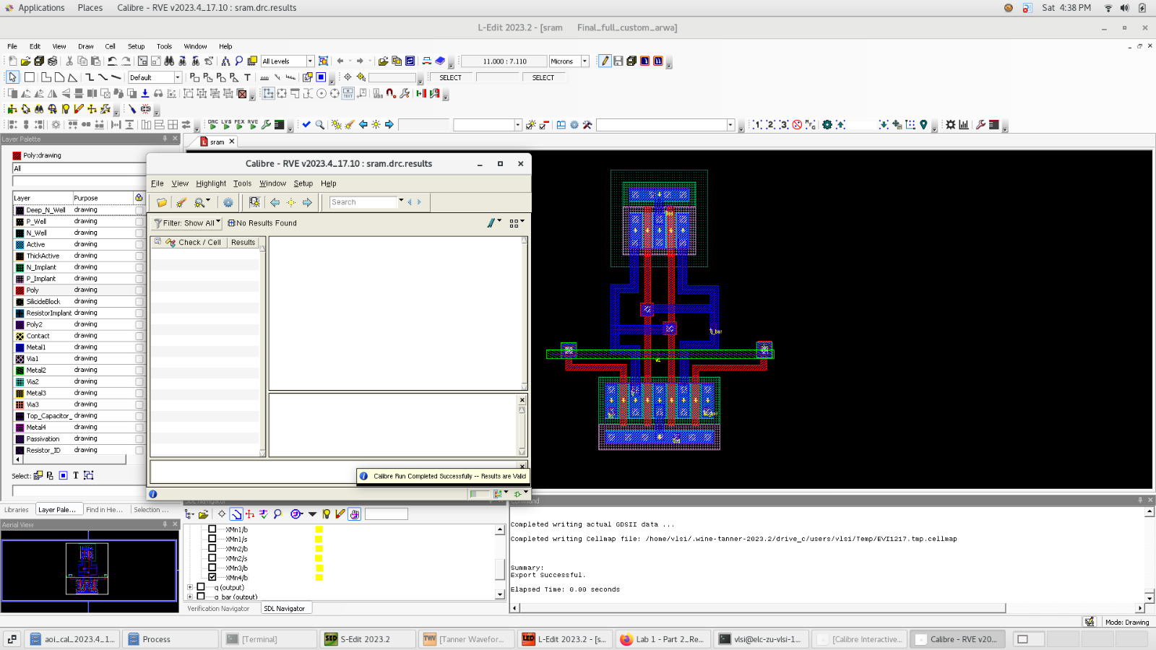
S ram

Slide 33
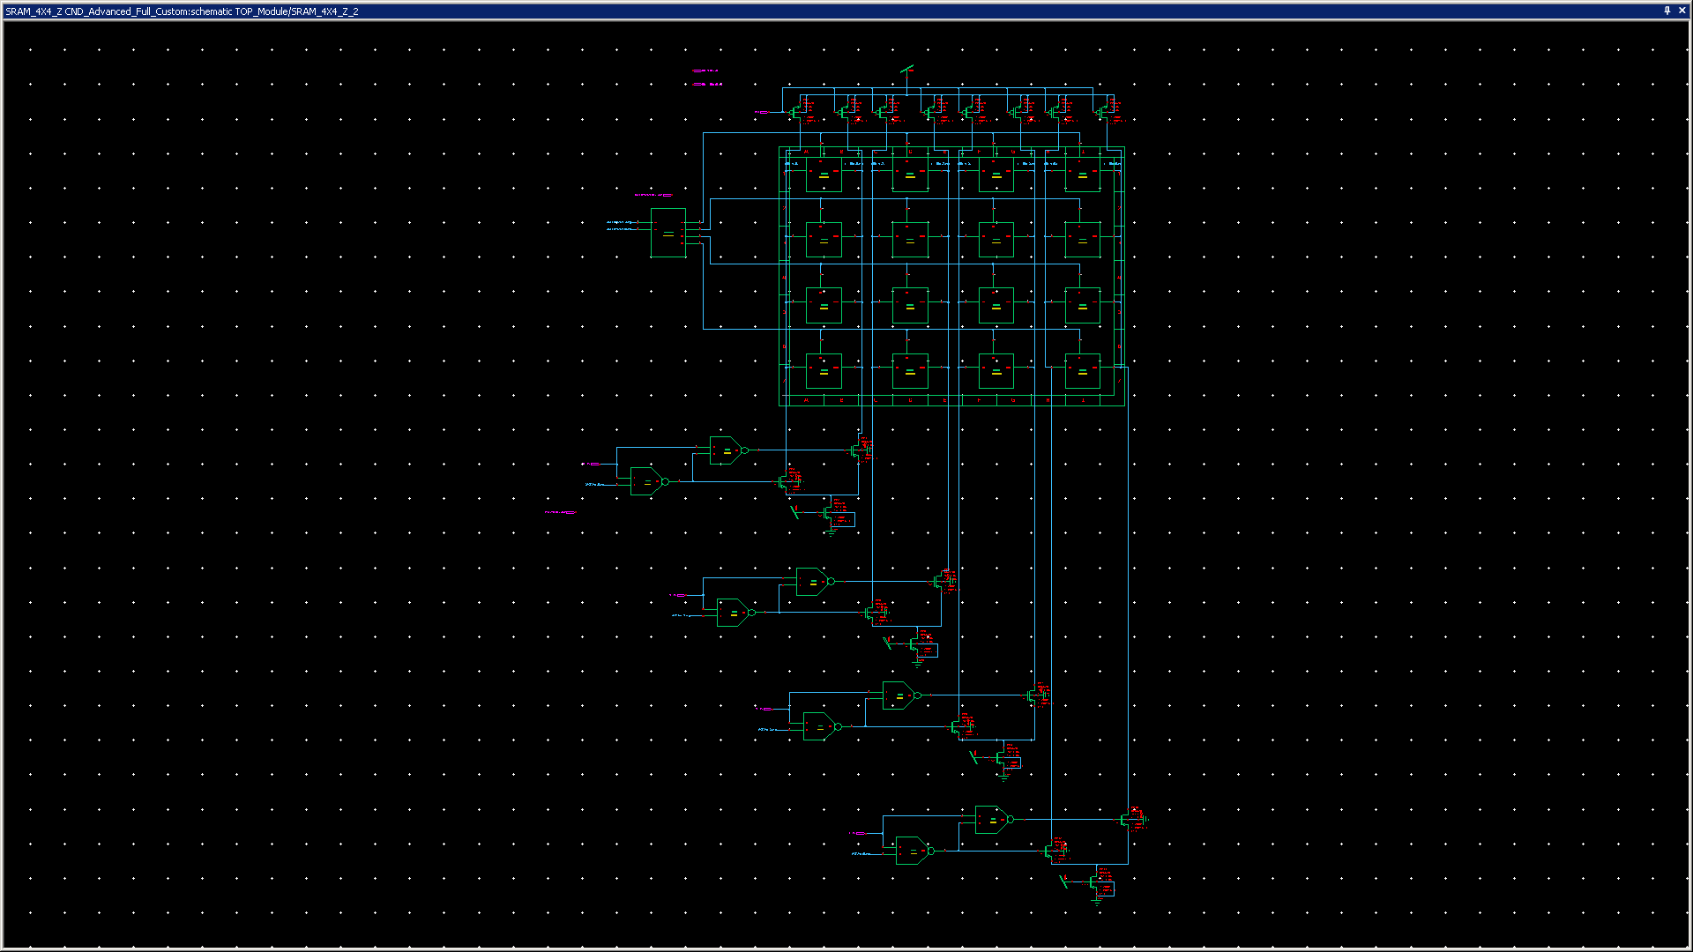
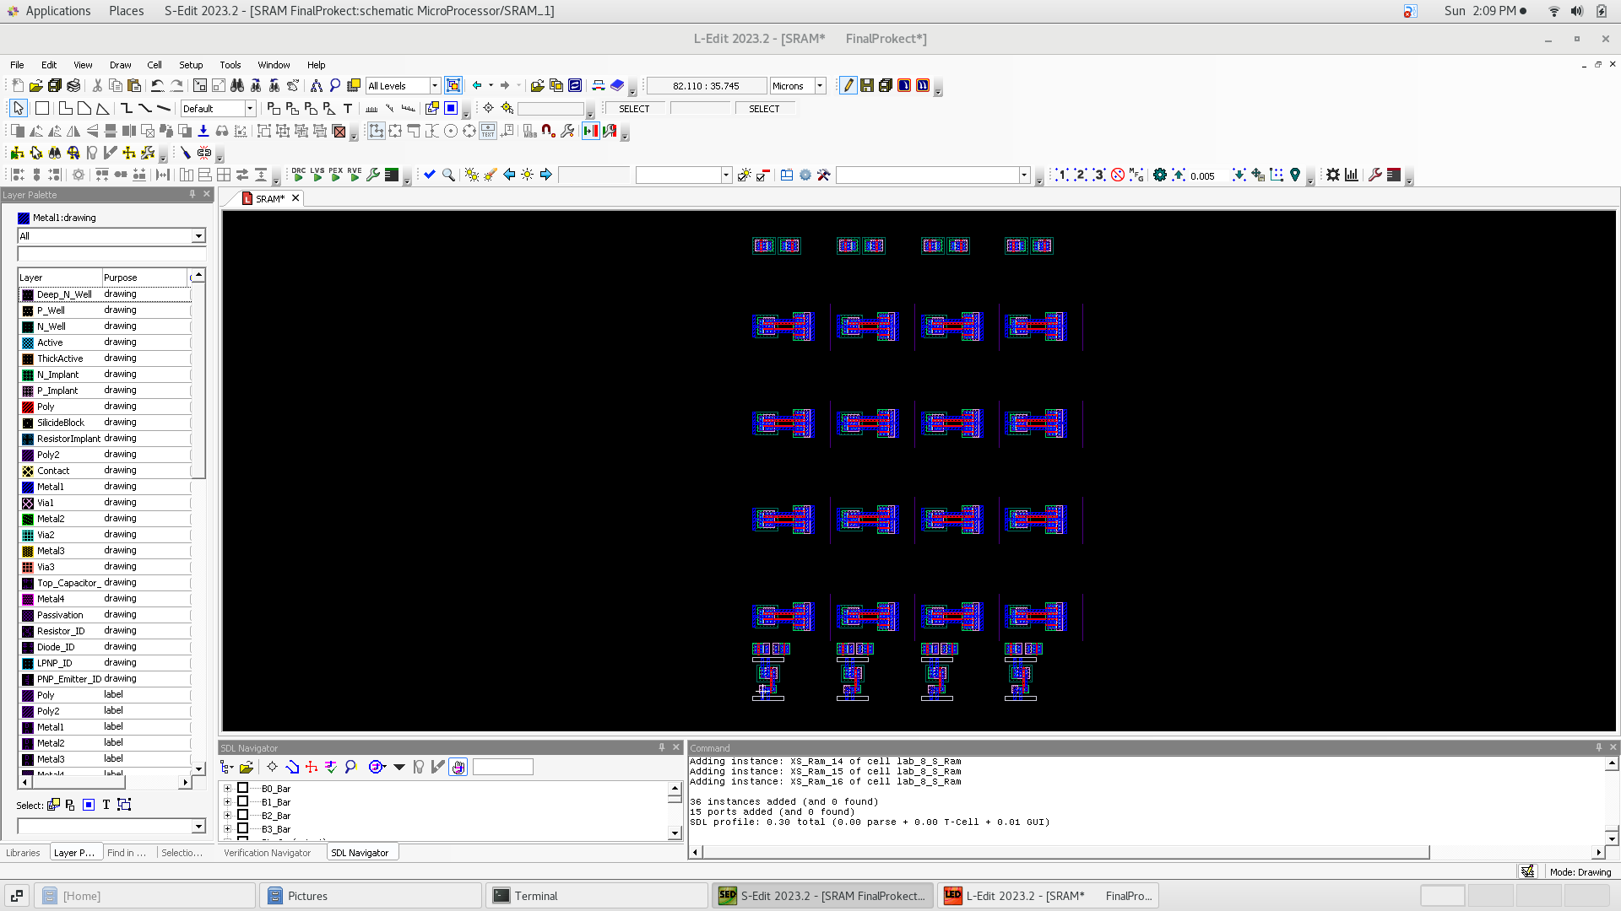
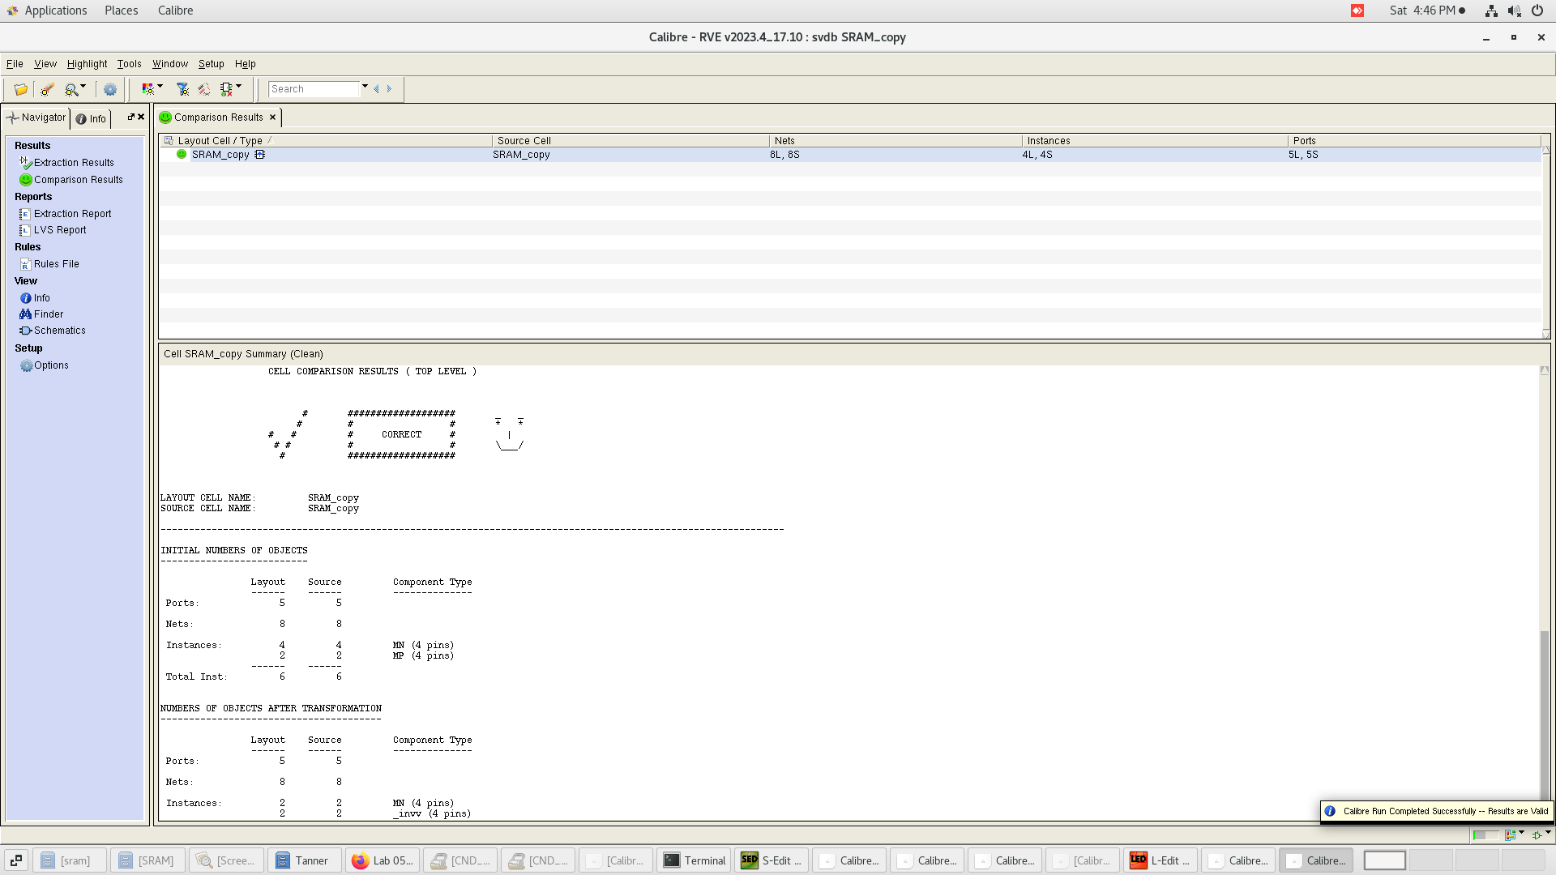
S ram 4*4

Slide 34
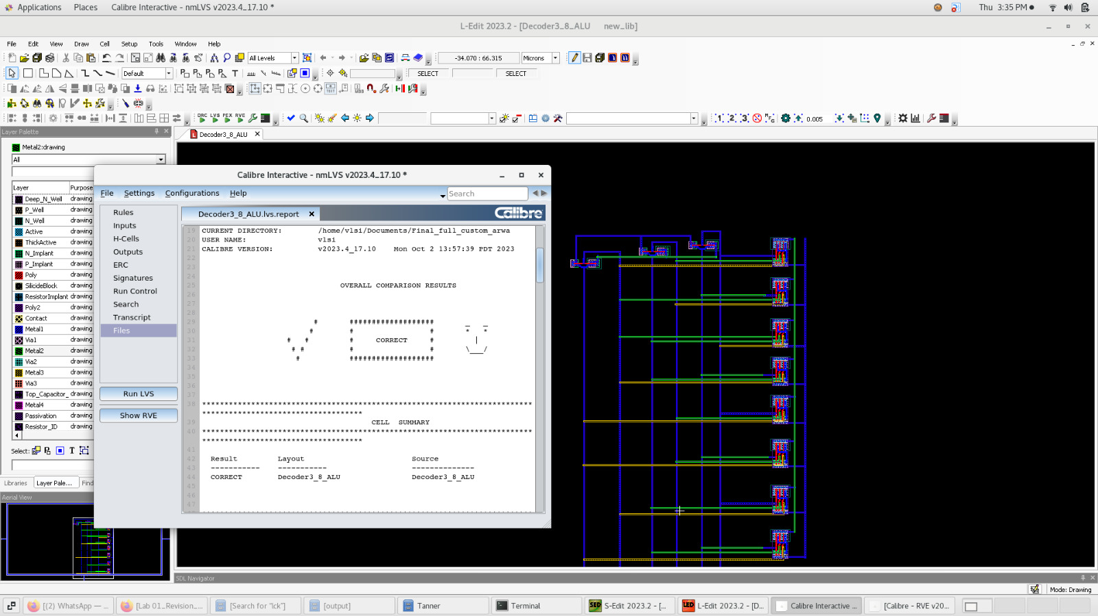
S ram decoder

Slide 35
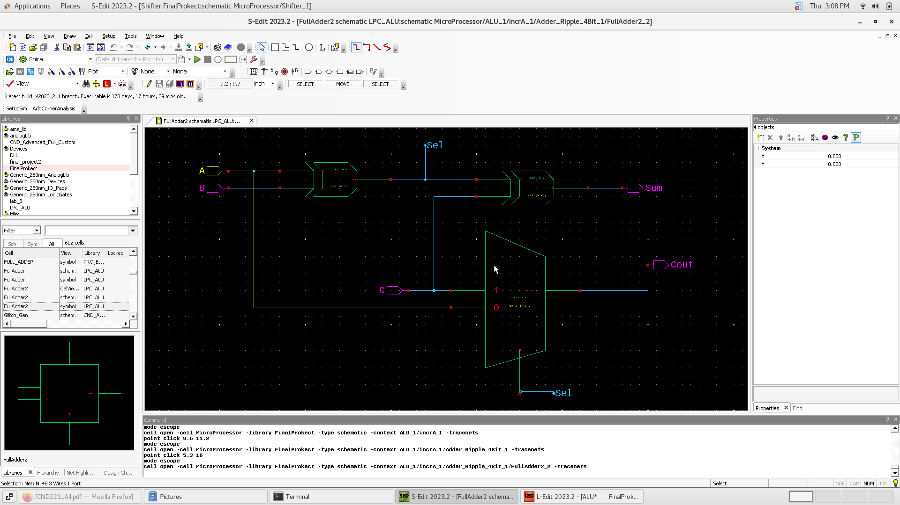
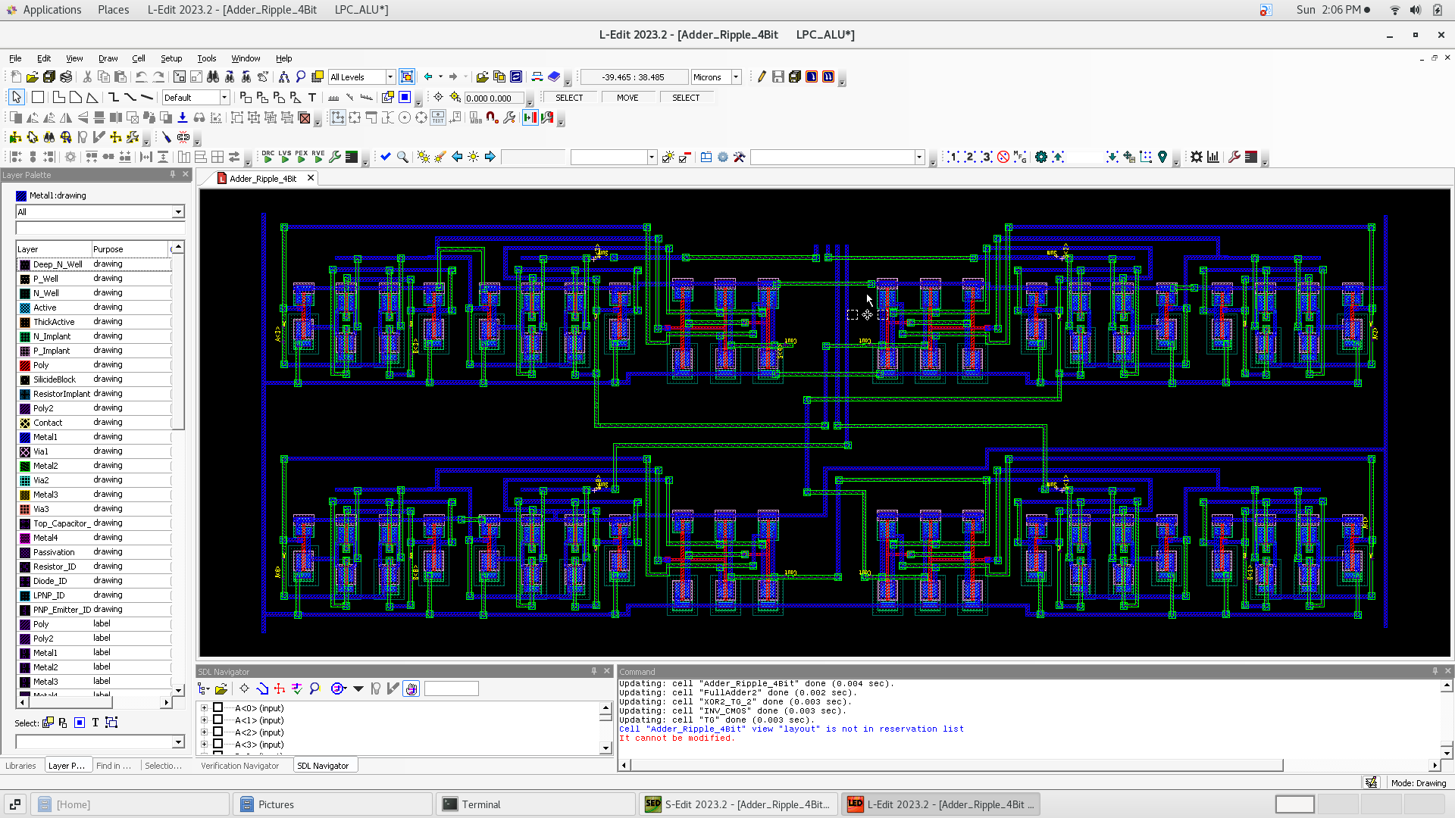
Full adder

Slide 36
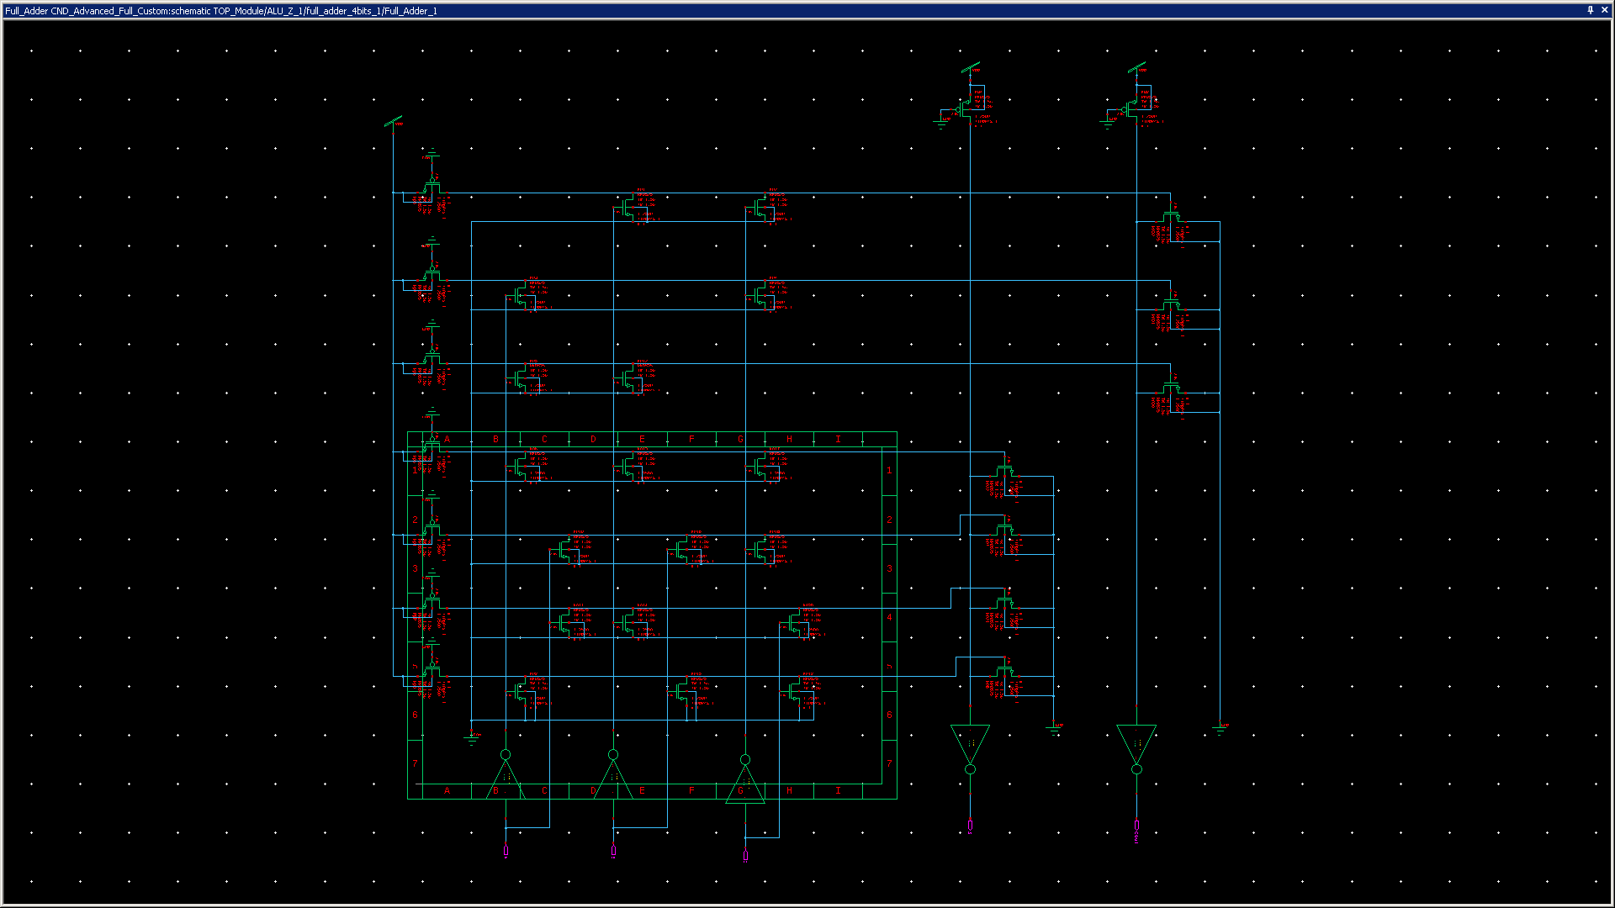
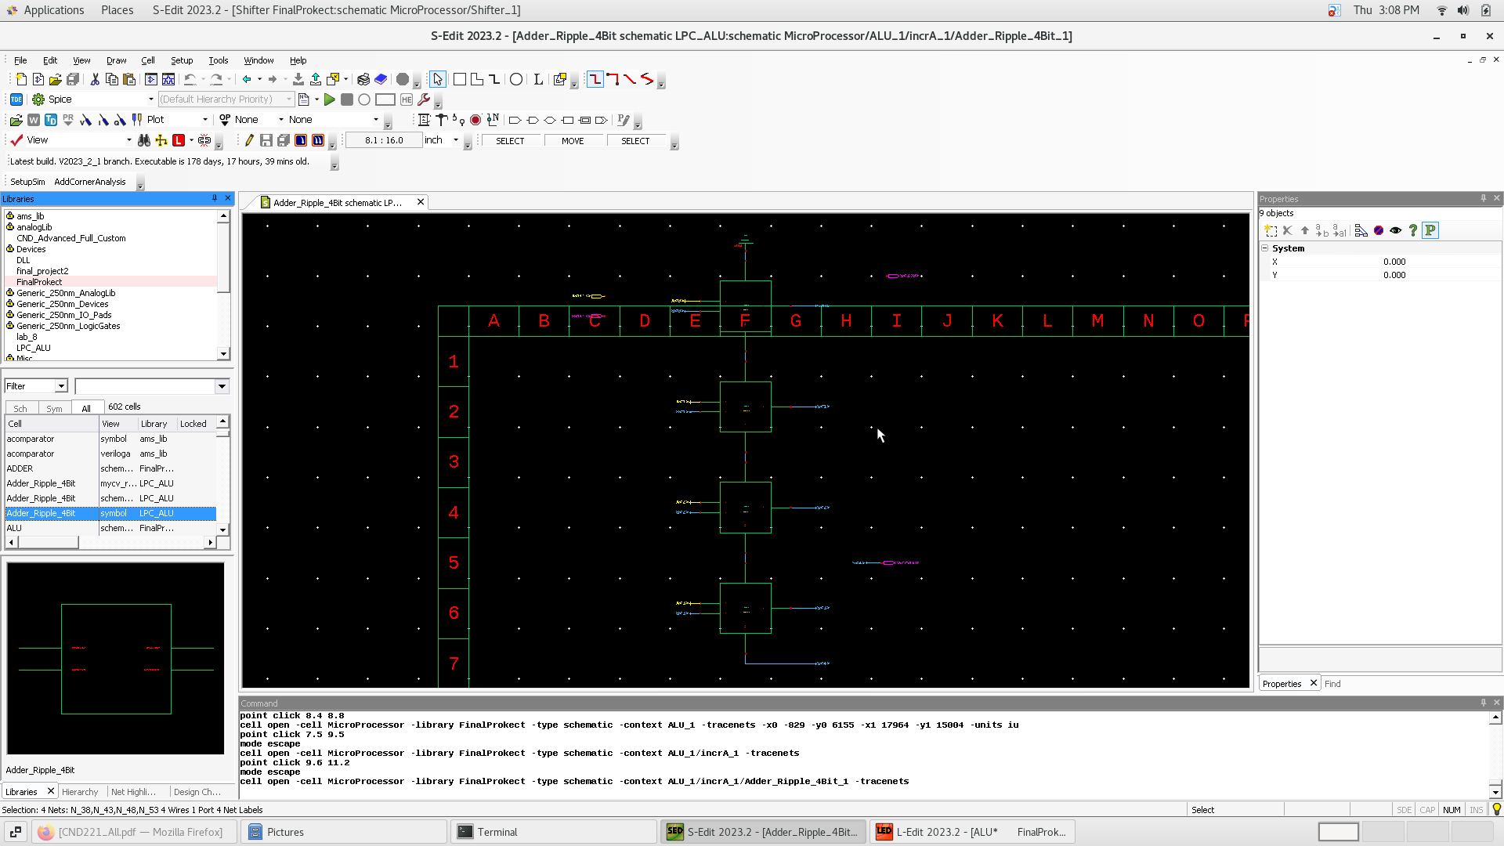
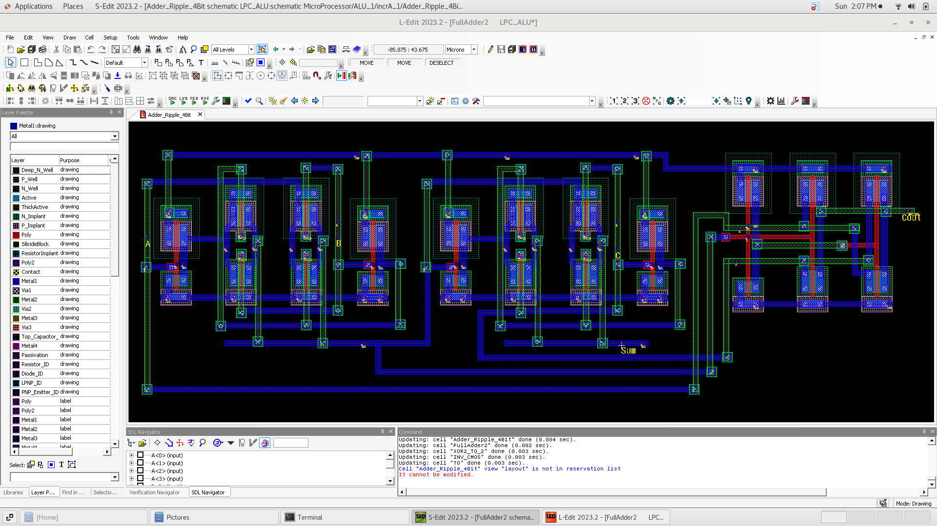
Adder ribble

Slide 37
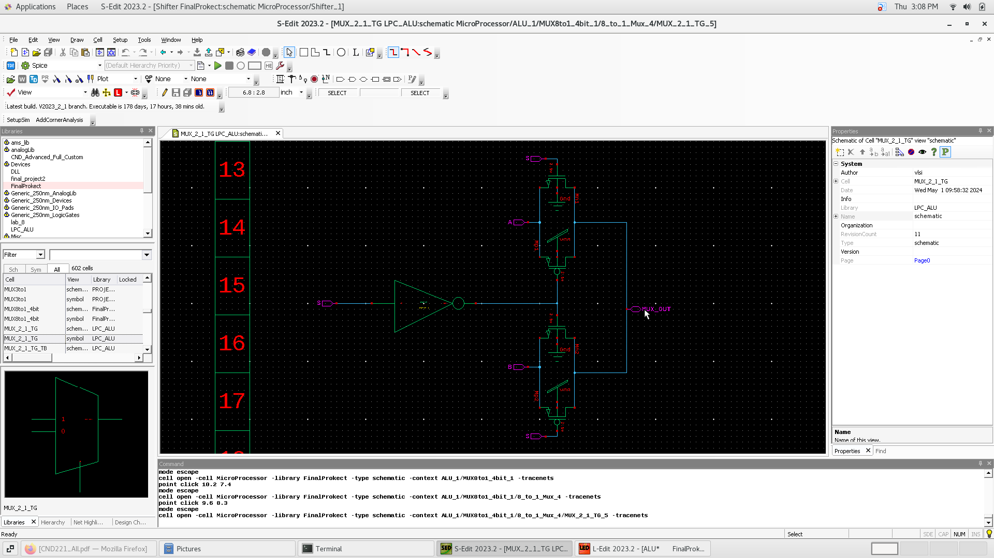
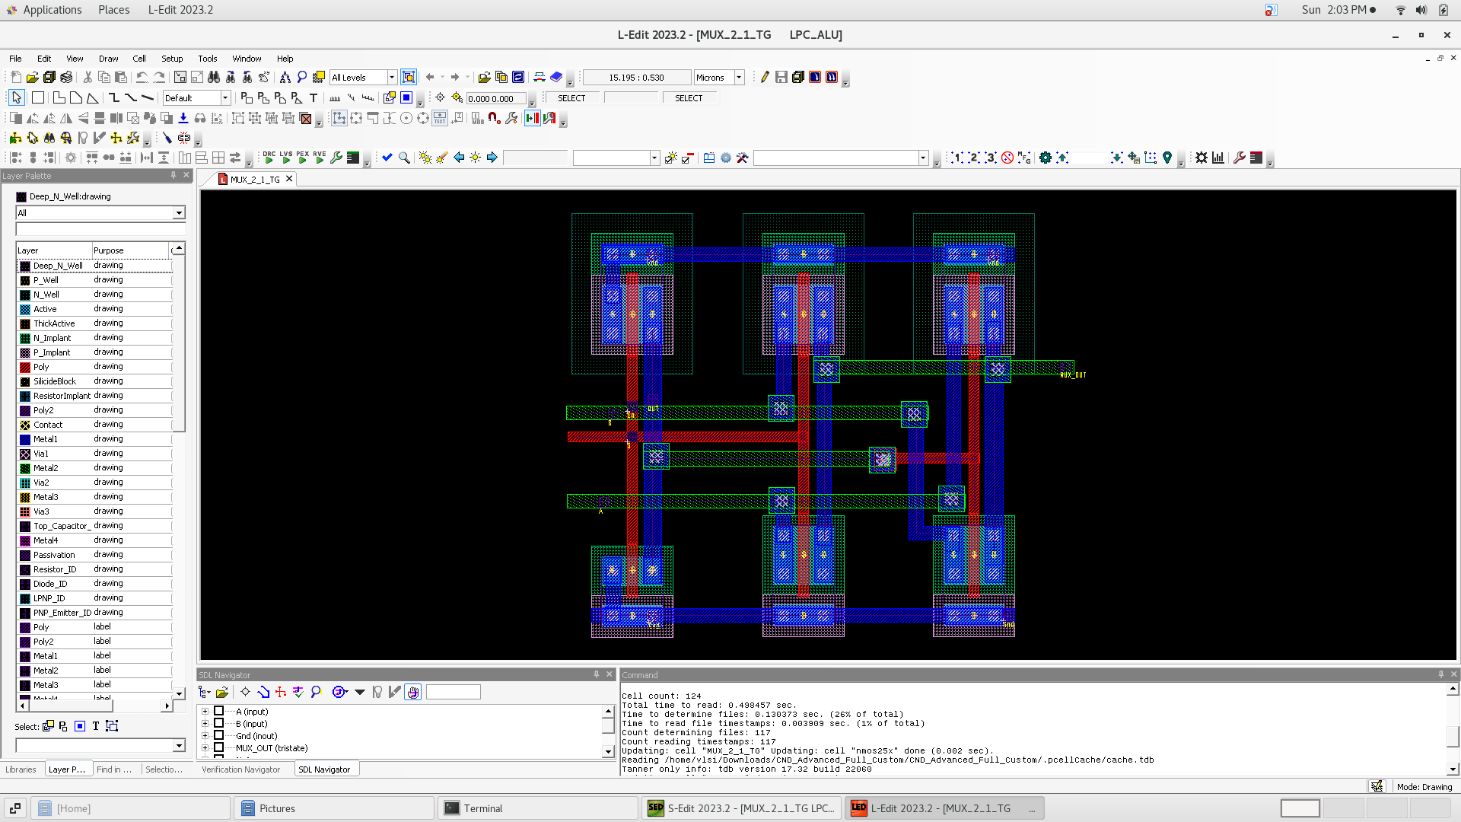
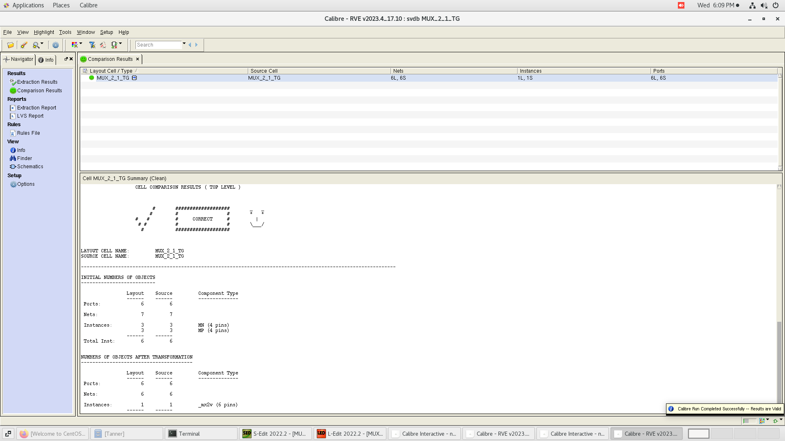
Mux 2 to 1

Slide 38
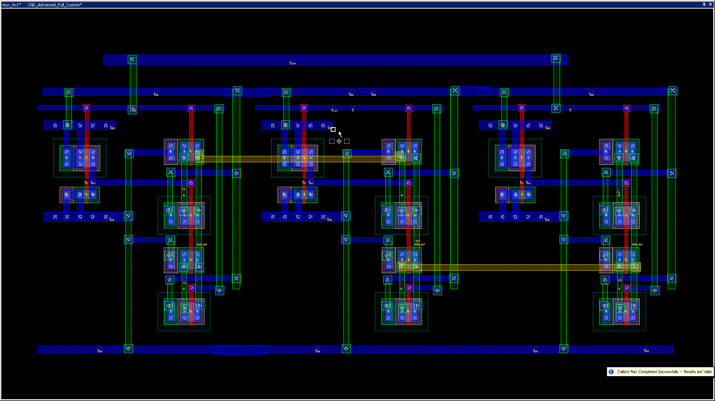
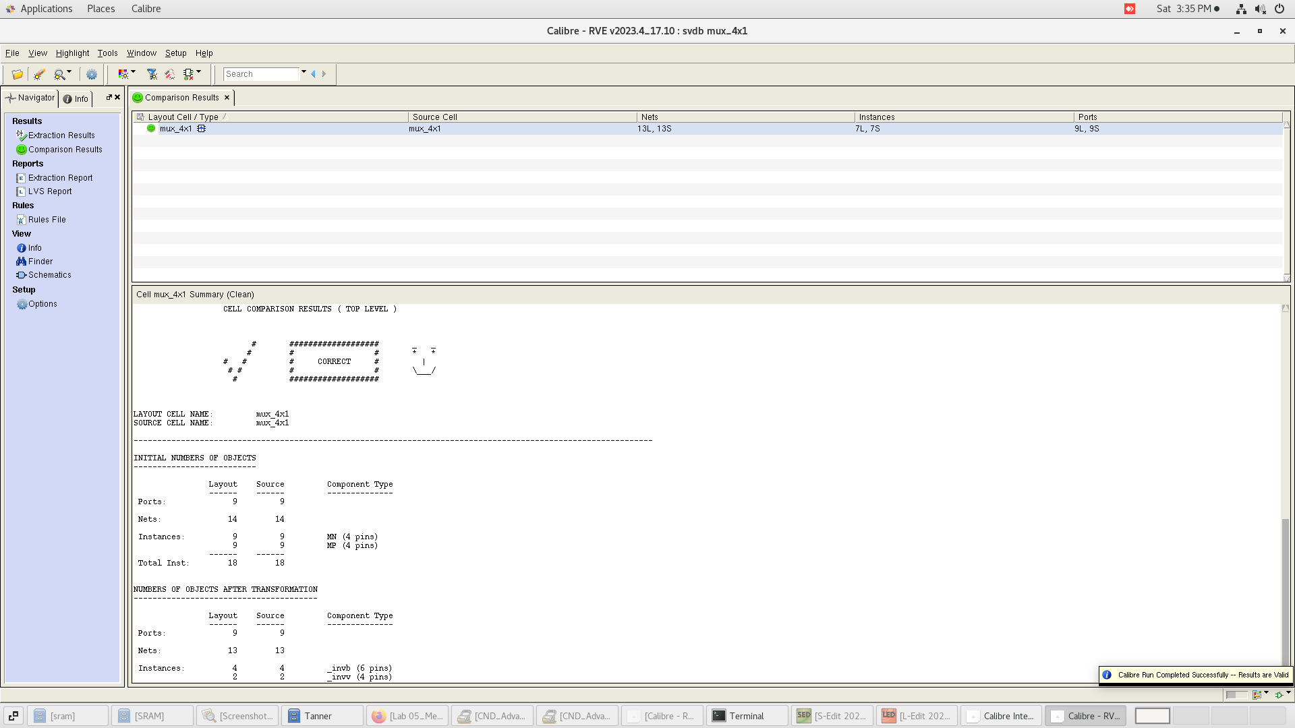
Mux 4*1

Slide 39
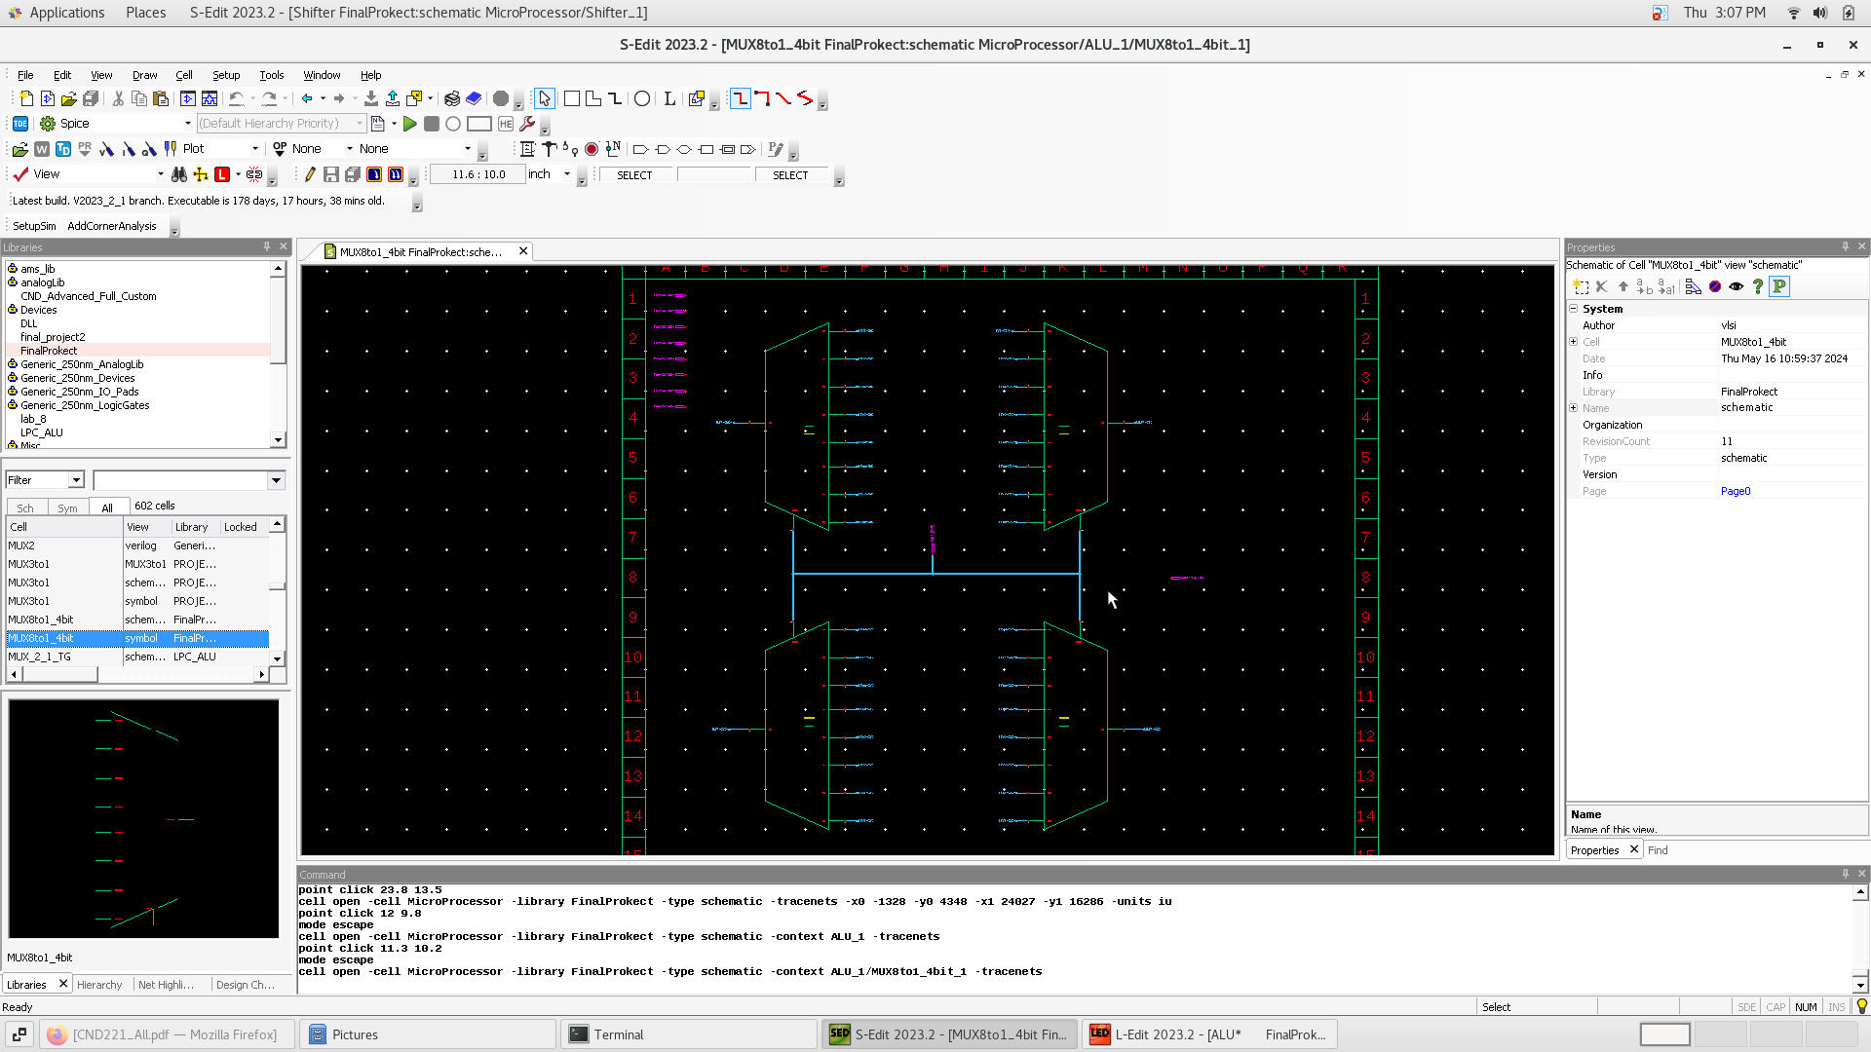
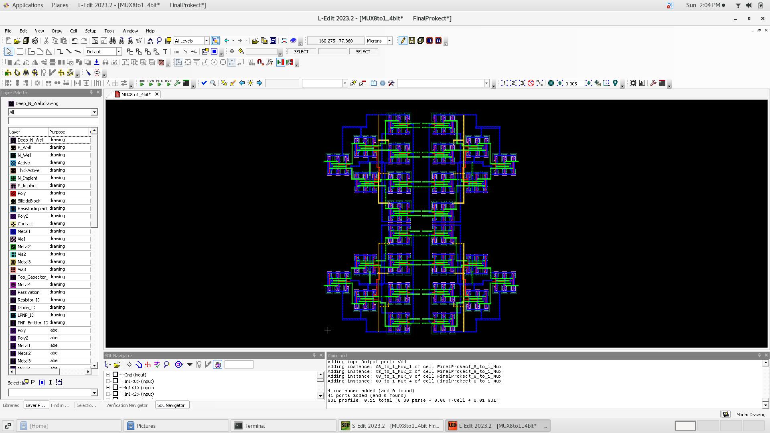
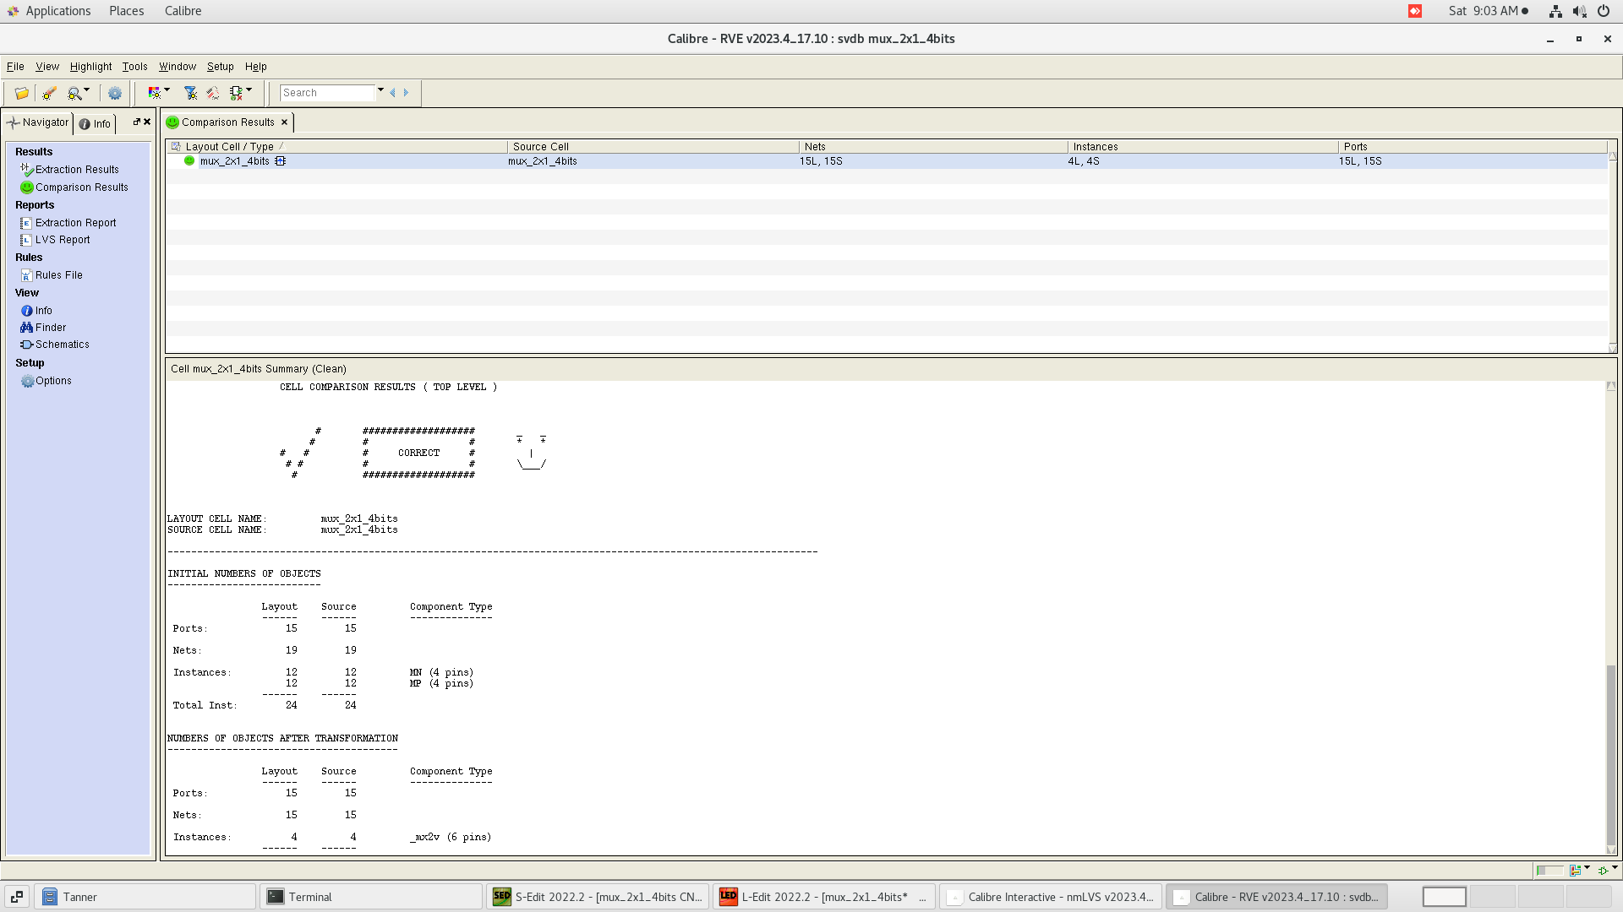
Mux8to1 4bit

Slide 40
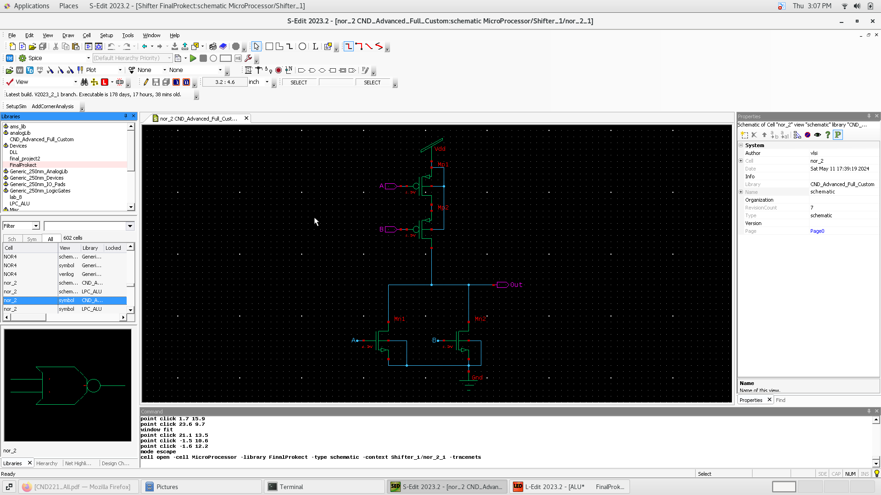
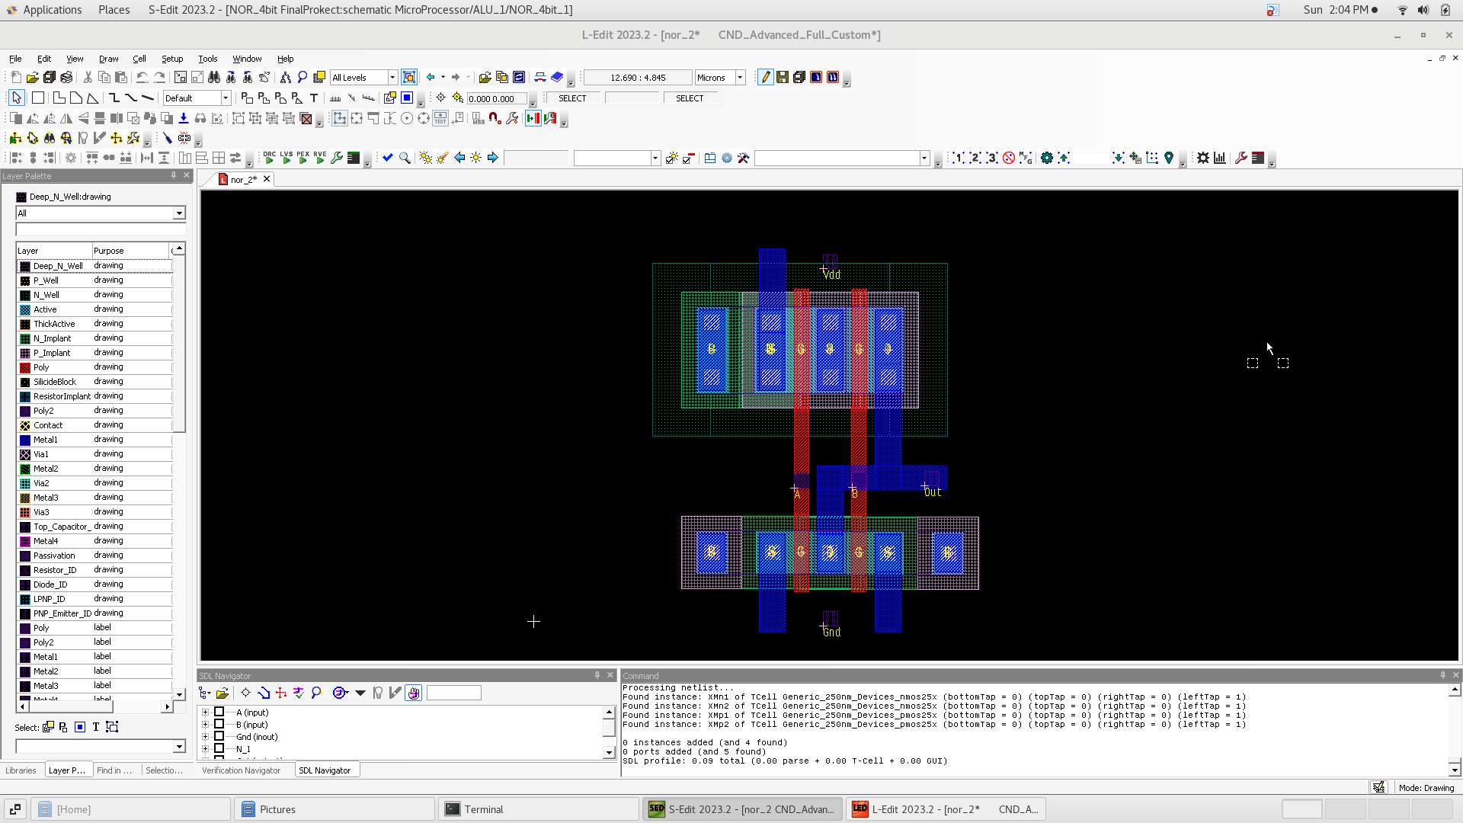
nor

Slide 41
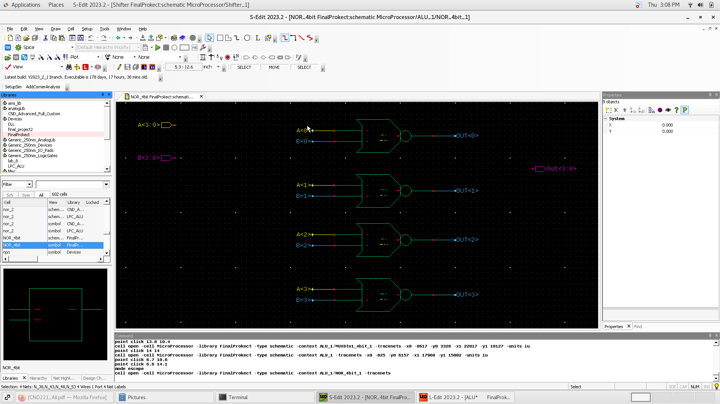
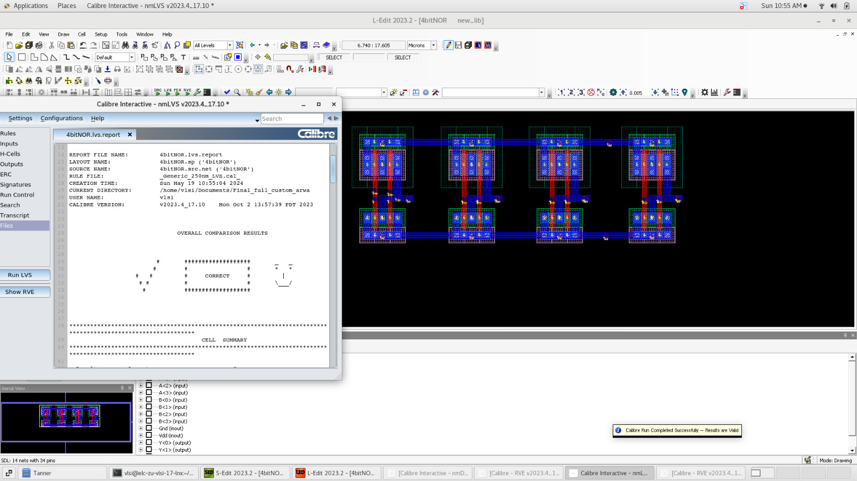
Nor 4 bit

Slide 42
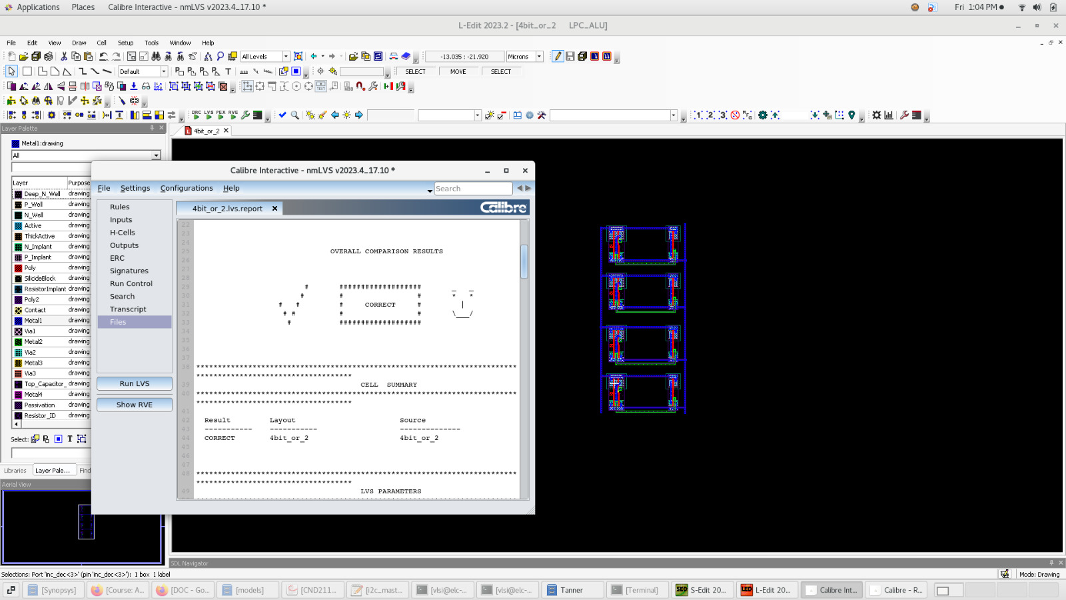
4 bit or

Slide 43
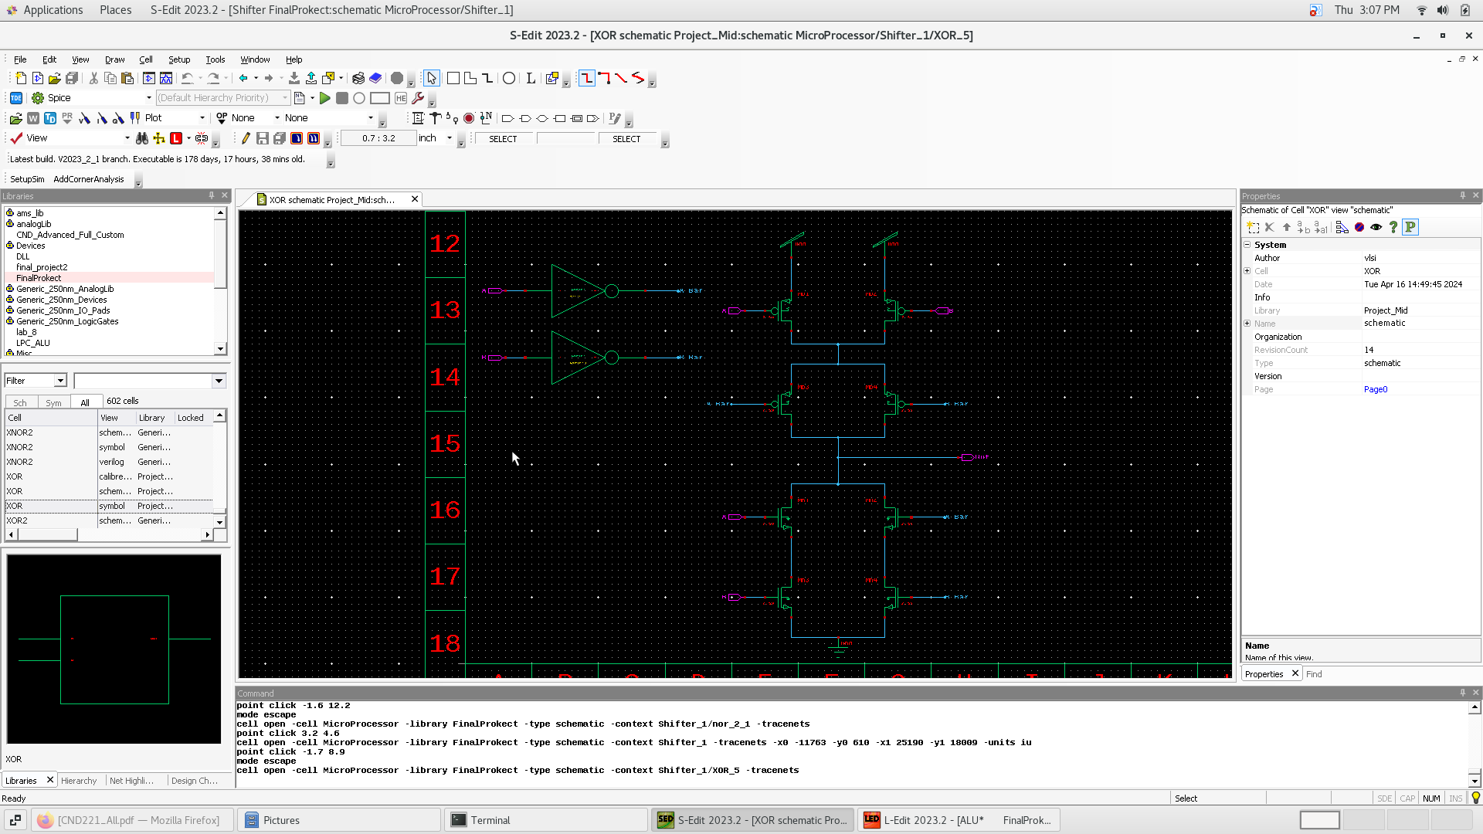
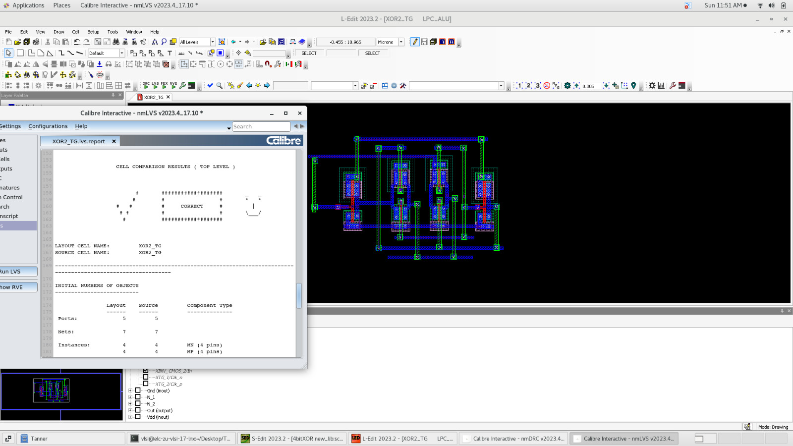
xor

Slide 44
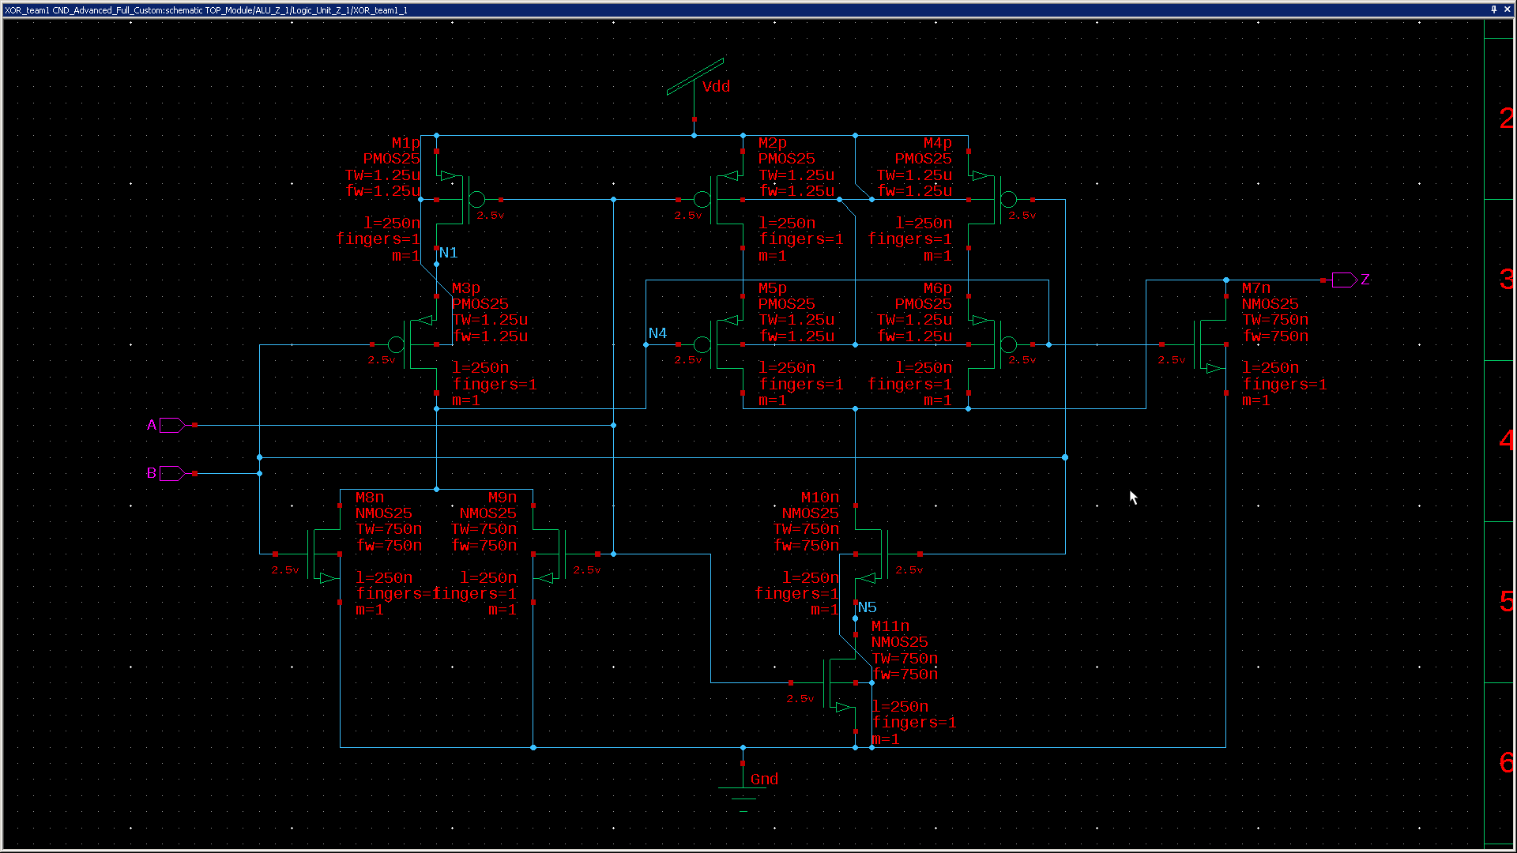
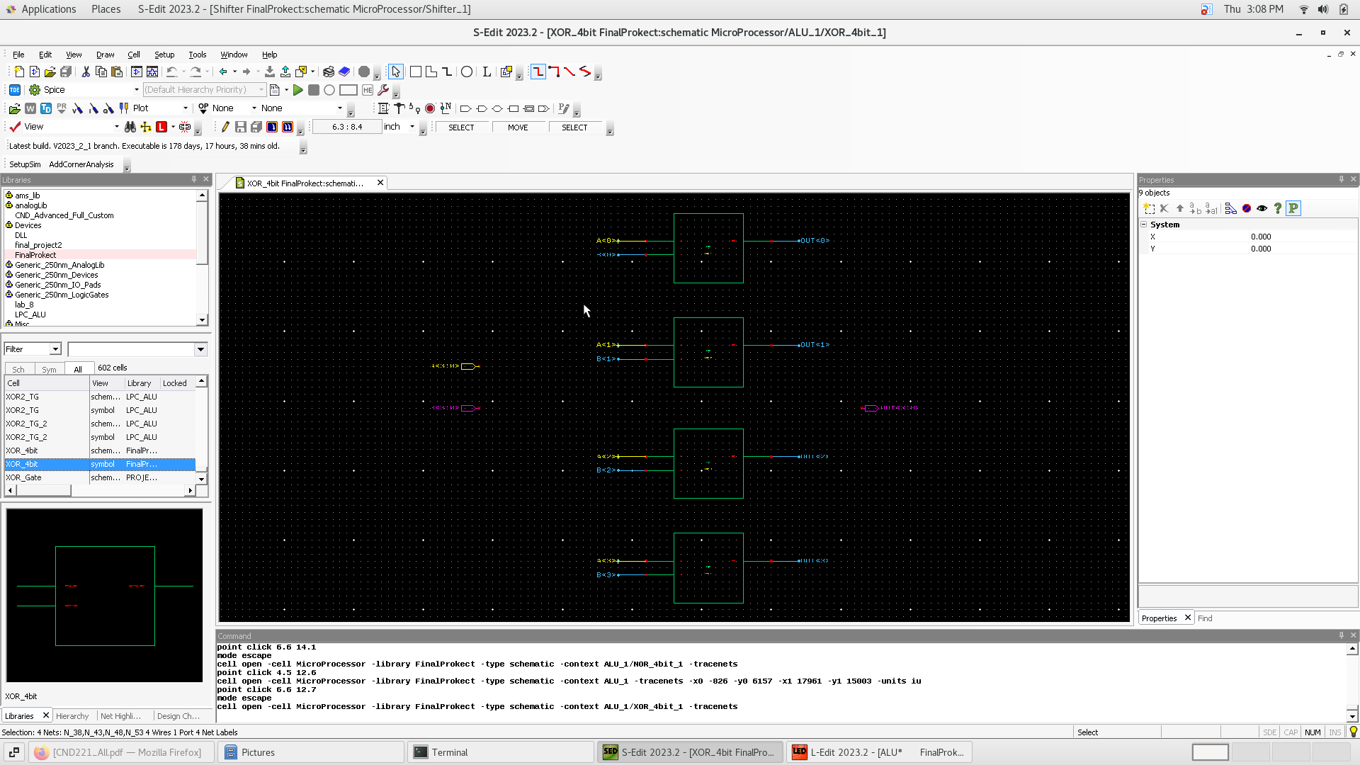
Xor 4 bit

Slide 45
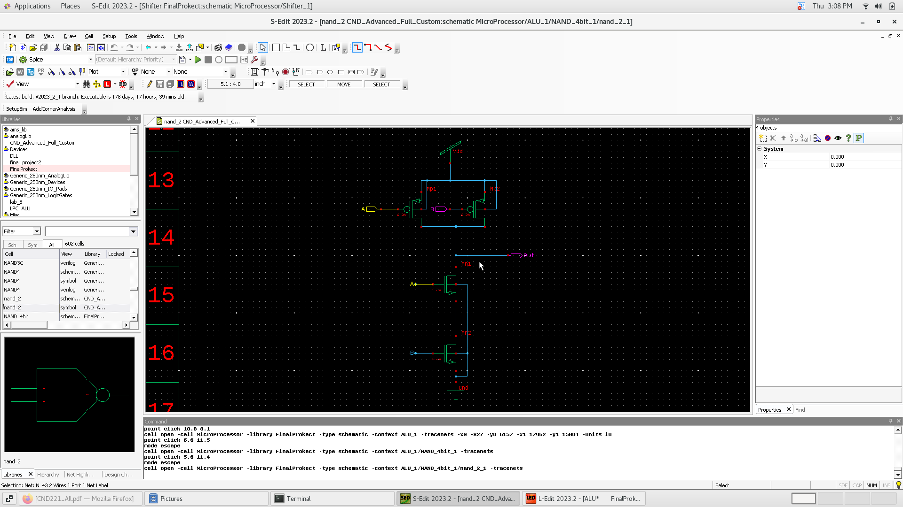
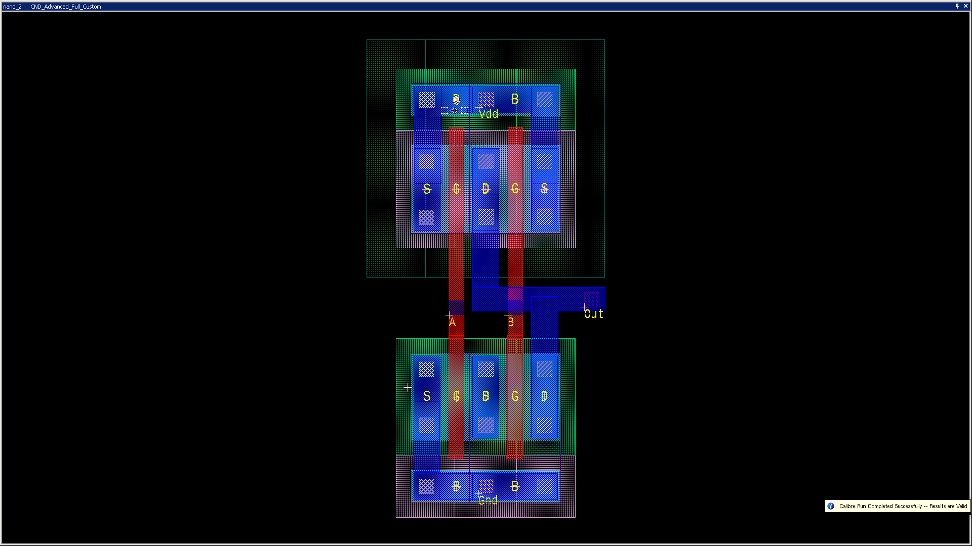
nand

Slide 46
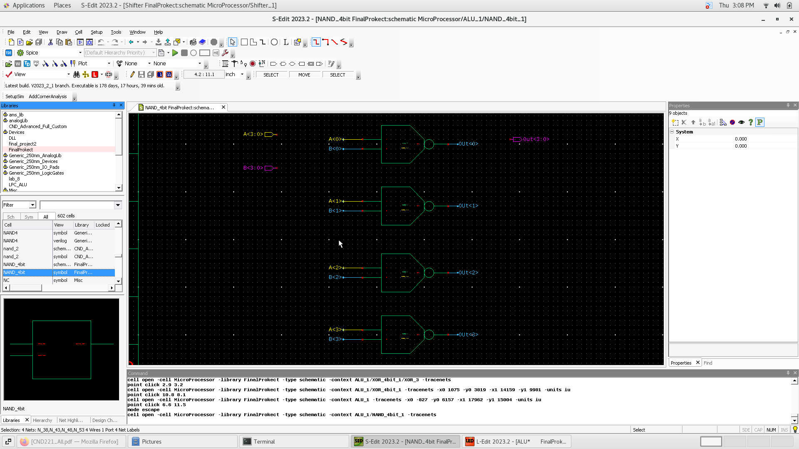
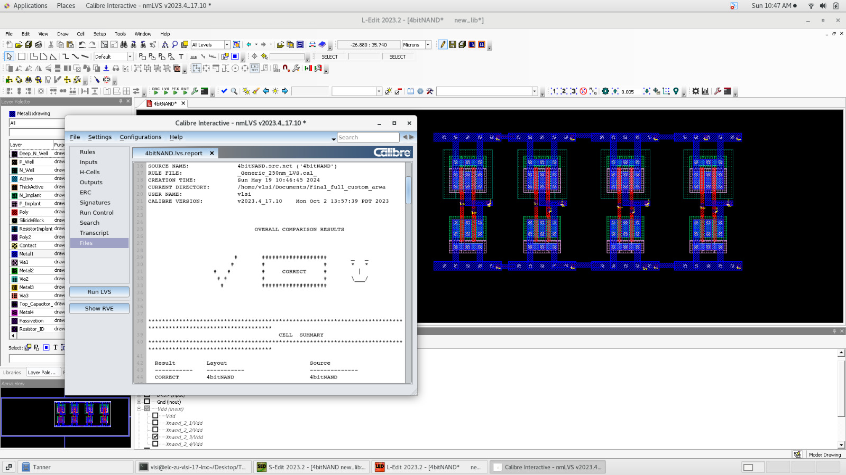
Nand 4 bit

Slide 47
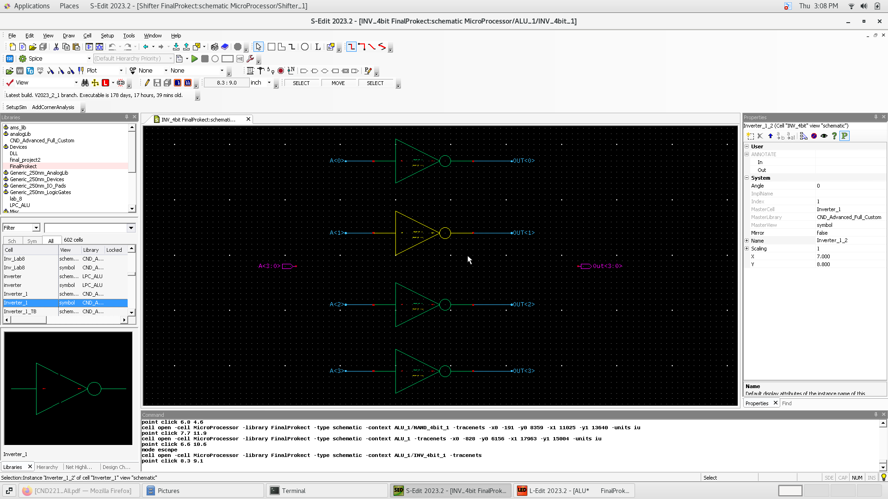

Inverter 4 bit

Slide 48

Incr a

Slide 49


Decr a

Slide 50

Char 1

Slide 51

Char

Slide 52

For more information, click on the GetHub link or Scan the QR
https://github.com/tito642/4-bit-Microprocessor-Design-and-Implementation

